Slide 1



PROGRESS REPORT
DISTRICT –
REGION
, 2023

Slide 2
District Overview
Taluka | Category | No. of Schemes | Work Order Issued | Work In Progress | Work Not Started
Arni | Retro | 81 | 81 | 50 | 31
 | New | 8 | 8 | 3 | 5
Babhulgaon | Retro | 51 | 51 | 45 | 6
 | New | 4 | 4 | 2 | 2
Darwha | Retro | 70 | 70 | 52 | 18
 | New | 7 | 7 | 3 | 4
Digras | Retro | 65 | 65 | 28 | 37
 | New | 6 | 6 | 4 | 2
Ghatanji | Retro | 69 | 69 | 40 | 29
 | New | 21 | 21 | 10 | 11
Kalamb | Retro | 55 | 55 | 25 | 30
 | New | 35 | 35 | 19 | 16
Kelapur | Retro | 39 | 39 | 22 | 17
 | New | 7 | 7 | 3 | 4
Mahagaon | Retro | 90 | 90 | 59 | 31
 | New | 2 | 2 | 1 | 1

Slide 3
District Overview
Taluka | Category | No. of Schemes | Work Order Issued | Work In Progress | Work Not Started
Maregaon | Retro | 56 | 56 | 26 | 30
 | New | 49 | 49 | 17 | 32
Ner | Retro | 53 | 53 | 28 | 25
 | New | 9 | 9 | 5 | 4
Pusad | Retro | 106 | 106 | 47 | 59
 | New | 1 | 1 | 1 | 0
Ralegaon | Retro | 53 | 53 | 34 | 19
 | New | 41 | 41 | 14 | 27
Umarkhed | Retro | 106 | 106 | 72 | 34
 | New | 8 | 8 | 1 | 7
Wani | Retro | 68 | 68 | 29 | 39
 | New | 52 | 52 | 22 | 30
Yavatmal | Retro | 73 | 73 | 46 | 27
 | New | 11 | 11 | 5 | 6

Slide 4
District Overview
Taluka | Category | No. of Schemes | Work Order Issued | Work In Progress | Work Not Started
Zari Jamni | Retro | 57 | 57 | 22 | 35
 | New | 39 | 39 | 18 | 21
Total | Retro | 1092 | 1092 | 625 | 467
 | New | 300 | 300 | 128 | 172
Grand Total |  | 1392 | 1392 | 753 | 639
 |  | 1392 | 1392 | 753 | 639

Slide 5
Executive Summary Work in Progress Schemes
Taluka | Category | No. of Schemes | No. of Schemes based on Physical Progress %
 |  |  | < 25% | 25 < 50% | 50 < 75% | 75 < 100% | Commissioned
Arni | Retro | 50 | 47 | 3 | 0 | 0 | 0
 | New | 3 | 2 | 0 | 0 | 1 | 0
Babhulgaon | Retro | 45 | 33 | 7 | 3 | 2 | 0
 | New | 2 | 1 | 0 | 0 | 1 | 0
Darwha | Retro | 52 | 26 | 12 | 12 | 2 | 0
 | New | 3 | 2 | 0 | 0 | 1 | 0
Digras | Retro | 28 | 25 | 3 | 0 | 0 | 0
 | New | 4 | 3 | 1 | 0 | 0 | 0
Ghatanji | Retro | 40 | 25 | 11 | 4 | 0 | 0
 | New | 10 | 5 | 3 | 1 | 1 | 0
Kalamb | Retro | 25 | 17 | 5 | 3 | 0 | 0
 | New | 19 | 11 | 5 | 0 | 3 | 0
Kelapur | Retro | 22 | 20 | 1 | 0 | 1 | 0
 | New | 3 | 1 | 1 | 1 | 0 | 0

Slide 6
Executive Summary Work in Progress Schemes
Taluka | Category | No. of Schemes | No. of Schemes based on Physical Progress %
 |  |  | < 25% | 25 < 50% | 50 < 75% | 75 < 100% | Commissioned
Mahagaon | Retro | 59 | 52 | 6 | 1 | 0 | 0
 | New | 1 | 1 | 0 | 0 | 0 | 0
Maregaon | Retro | 26 | 23 | 3 | 0 | 0 | 0
 | New | 17 | 13 | 1 | 1 | 1 | 1
Ner | Retro | 28 | 20 | 6 | 1 | 1 | 0
 | New | 5 | 4 | 1 | 0 | 0 | 0
Pusad | Retro | 47 | 39 | 8 | 0 | 0 | 0
 | New | 1 | 1 | 0 | 0 | 0 | 0
Ralegaon | Retro | 34 | 24 | 7 | 3 | 0 | 0
 | New | 14 | 9 | 1 | 0 | 2 | 2
Umarkhed | Retro | 72 | 64 | 5 | 2 | 1 | 0
 | New | 1 | 1 | 0 | 0 | 0 | 0
Wani | Retro | 29 | 22 | 6 | 1 | 0 | 0
 | New | 22 | 17 | 1 | 1 | 3 | 0

Slide 7
Executive Summary Work in Progress Schemes
Taluka | Category | No. of Schemes | No. of Schemes based on Physical Progress %
 |  |  | < 25% | 25 < 50% | 50 < 75% | 75 < 100% | Commissioned
Yavatmal | Retro | 45 | 36 | 7 | 2 | 0 | 0
 | New | 5 | 3 | 2 | 0 | 0 | 0
Zari Jamni | Retro | 22 | 20 | 1 | 1 | 0 | 0
 | New | 18 | 15 | 1 | 2 | 0 | 0
Total | Retro | 624 | 493 | 91 | 33 | 7 | 0
 | New | 128 | 89 | 17 | 6 | 13 | 3
Grand Total |  | 752 | 582 | 108 | 39 | 20 | 3

Slide 8
Abstract of Schemes – Work in Progress Category – “Retro”
Sr No | Scheme Name | Name of Agency | W.O. Amount (excl GST) | W.O. Date | Construction Period | Physical Progress | RA Bill (Recommended) % | RA Bill (Recommended) In Lakhs
Arni Taluka | Arni Taluka
1 | Kapeshwar | Akash Mohale | 73,56,413 | 06-10-2022 | 15 Months | 48.50% | 15.51% | 11.41
2 | Lonbehel | Ashwajit Gayakwad | 1,18,43,911 | 11-05-2022 | 18 Months | 40.26% | - | -
3 | Khed | Ashwajit Gayakwad | 1,10,59,497 | 08-07-2022 | 18 Months | 32.57% | 10.60% | 11.72
4 | Gudha | Santosh Sidam | 26,68,414 | 13-01-2023 | 7 Months | 24.23% | - | -
5 | Shirpur | Ashwajit Gayakwad | 77,56,825 | 23-08-2022 | 16 Months | 21.46% | - | -
6 | Saikheda | Ashwajit Gayakwad | 90,85,832 | 25-11-2022 | 15 Months | 20.45% | - | -
7 | Daheli & Pawannagar | Anurag Mantri | 84,36,293 | 04-10-2022 | 12 Months | 19.96% | 14.44% | 12.19
8 | Umari Pathar | N. J. Sharma And Sons | 95,06,508 | 01-07-2022 | 18 Months | 18.79% | - | -
9 | Umari (Kapeshwar) | Yogesh Meshram | 70,42,606 | 17-10-2022 | 15 Months | 15.70% | - | -
10 | Sudhakarnagar | Gulab Gajghate | 31,43,094 | 04-10-2022 | 12 Months | 14.83% | - | -
11 | Chatari | Gulab Gajghate | 26,52,705 | 16-09-2022 | 10 Months | 14.55% | - | -
12 | Naiknagarheti | Ashwajit Gayakwad | 93,78,978 | 15-09-2022 | 15 Months | 14.42% | 5.11% | 4.79
13 | Khandala | R. H. Baig Construction | 42,13,441 | 01-07-2022 | 18 Months | 13.84% | - | -

Slide 9
Abstract of Schemes – Work in Progress Category – “Retro”
Sr No | Scheme Name | Name of Agency | W.O. Amount (excl GST) | W.O. Date | Construction Period | Physical Progress | RA Bill (Recommended) % | RA Bill (Recommended) In Lakhs
14 | Umari Ijara | Ashwajit Gayakwad | 61,21,127 | 23-08-2022 | 16 Months | 12.55% | 10.39% | 6.36
15 | Asara | Ashwajit Gayakwad | 55,51,688 | 23-08-2022 | 16 Months | 12.28% | 11.65% | 6.47
16 | Pangari | Ashwajit Gayakwad | 87,81,032 | 08-07-2022 | 18 Months | 12.22% | 9.89% | 8.69
17 | Lingi | S. J. Sharma & Sons | 32,27,392 | 11-11-2022 | 10 Months | 11.54% | - | -
18 | Kinhi | R. H. Beg Construction | 25,04,381 | 11-11-2022 | 10 Months | 11.50% | - | -
19 | Warud Bhakt | Akash Mohale | 78,20,938 | 18-10-2022 | 15 Months | 10.75% | 4.83% | 3.78
20 | Palashi & Manoharkhedi | Santosh Sidam | 45,04,193 | 13-01-2023 | 9 Months | 10.64% | - | -
21 | Deogaon | Hemant R. Sardar | 64,04,747 | 12-08-2022 | 18 Months | 10.63% | - | -
22 | Ivhewar | Viththalkrupa Construction Company | 14,99,834 | 19-08-2022 | 10 Months | 9.79% | - | -
23 | Anjankhed | Ashwajit Gayakwad | 35,03,714 | 07-06-2022 | 18 Months | 9.47% | - | -
24 | Tendoli | Gughane Infrastructure | 50,36,303 | 27-12-2022 | 12 Months | 9.38% | - | -
25 | Ichora | Ashwajit Gayakwad | 64,56,265 | 29-08-2022 | 15 Months | 7.35% | - | -
26 | Taroda | Arvind Padmawar | 70,11,948 | 04-07-2022 | 18 Months | 6.03% | - | -
27 | Gawana | Hemant R. Sardar | 52,69,944 | 12-08-2022 | 18 Months | 5.49% | - | -

Slide 10
Abstract of Schemes – Work in Progress Category – “Retro”
Sr No | Scheme Name | Name of Agency | W.O. Amount (excl GST) | W.O. Date | Construction Period | Physical Progress | RA Bill (Recommended) % | RA Bill (Recommended) In Lakhs
28 | Rudrapur | Ashwajit Gayakwad | 74,81,094 | 06-12-2022 | 12 Months | 4.48% | - | -
29 | Loni | Ashwajit Gayakwad | 89,05,918 | 22-09-2022 | 15 Months | 4.17% | - | -
30 | Barbhai | Gulab Gajghate | 25,73,072 | 11-11-2022 | 10 Months | 3.52% | - | -
31 | Yermal | Gulab Gajghate | 18,91,742 | 04-01-2023 | 10 Months | 3.13% | - | -
32 | Pahur | G. K. Energy Marketers Pvt Ltd | 88,48,478 | 25-01-2023 | 12 Months | 2.83% | - | -
33 | Kelzara Warthi | Tirupati Associators | 40,78,786 | 16-09-2022 | 10 Months | 2.69% | - | -
34 | Gangaon | Vitthalkrupa Construction | 10,14,822 | 07-11-2022 | 10 Months | 2.06% | - | -
35 | Chinchbardi | Gulab Gajghate | 57,65,694 | 11-11-2022 | 15 Months | 1.95% | - | -
36 | Shivar | Arun Pawar | 39,93,106 | 25-01-2023 | 9 Months | 1.87% | - | -
37 | Mhasola | G. K. Energy Marketers Pvt Ltd | 82,86,960 | 25-01-2023 | 12 Months | 1.79% | - | -
38 | Ghonsara | Vitthalkrupa Construction Company | 47,42,752 | 13-09-2022 | 12 Months | 1.54% | - | -
39 | Shekalgaon | Vitthalkrupa Construction Company | 29,33,946 | 12-09-2022 | 10 Months | 1.27% | - | -
40 | Jamb | Vitthalkrupa Construction | 23,52,647 | 15-12-2022 | 7 Months | 1.03% | - | -
41 | Mukindpur | Ganeshrao Pandharkar | 53,45,245 | 17-10-2022 | 15 Months | 0.72% | - | -

Slide 11
Abstract of Schemes – Work in Progress Category – “Retro”
Sr No | Scheme Name | Name of Agency | W.O. Amount (excl GST) | W.O. Date | Construction Period | Physical Progress | RA Bill (Recommended) % | RA Bill (Recommended) In Lakhs
42 | Malegaon& Nilegaon | Gulab Gajghate | 1,12,48,079 | 15-11-2022 | 15 Months | 0.71% | - | -
43 | Palodi | Abhijit Dakhore | 55,89,757 | 26-12-2022 | 15 Months | 0.59% | - | -
44 | Subhashnagar | Gulab Gajghate | 54,21,846 | 25-01-2023 | 12 Months | 0.53% | - | -
45 | Shelu Shendursani | G. D. Pandharkar | 64,99,514 | 20-01-2023 | 12 Months | 0.46% | - | -
46 | Talani | Nikhil Maske | 72,10,518 | 16-01-2023 | 12 Months | 0.41% | - | -
47 | Borgaon Punji | Gulab Gajghate | 76,62,866 | 25-01-2023 | 12 Months | 0.40% | - | -
48 | Sawali | Gulab Gajghate | 88,26,054 | 30-01-2023 | 12 Months | 0.32% | - | -
49 | Bramhanwada & Pardhibeda | G. D. Pandharkar | 1,00,65,488 | 20-01-2023 | 12 Months | 0.30% | - | -
50 | Jawala & Jawala Heti | G. K. Energy Marketers Pvt Ltd | 1,23,67,385 | 25-01-2023 | 15 Months | 0.21% | - | -
Bahbhulgaon Taluka | Bahbhulgaon Taluka
51 | Pahur | Sunil Samdurkar | 60,61,628 | 07-06-2022 | 18 Months | 77.67% | 69.84% | 42.34
52 | Pimpri Iz | Sanjay Warate | 8,19,158 | 05-09-2022 | 6 Months | 76.35% | 64.09% | 5.25
53 | Kopra (Jan) | Sanjay Warate | 5,01,128 | 05-09-2022 | 6 Months | 57.49% | 51.44% | 2.58
54 | Gondhali | Hemant R. Sardar | 52,75,803 | 25-08-2022 | 12 Months | 54.83% | - | -

Slide 12
Abstract of Schemes – Work in Progress Category – “Retro”
Sr No | Scheme Name | Name of Agency | W.O. Amount (excl GST) | W.O. Date | Construction Period | Physical Progress | RA Bill (Recommended) % | RA Bill (Recommended) In Lakhs
55 | Alegaon | Sunil Samdurkar | 39,03,450 | 10-08-2022 | 18 Months | 51.98% | 35.68% | 13.93
56 | Paloti | Akash Mohale | 33,95,305 | 05-09-2022 | 12 Months | 37.48% | 36.01% | 12.23
57 | Watkhed Bk | R. U. Nalamwar | 68,80,616 | 21-07-2022 | 18 Months | 36.34% | 31.73% | 21.83
58 | Yerandgaon | Sunil Samdurkar | 1,03,80,809 | 23-08-2022 | 16 Months | 35.62% | 28.22% | 29.29
59 | Pachakhed | Akash Mohale | 60,97,270 | 05-09-2022 | 15 Months | 29.06% | 10.63% | 6.48
60 | Panchgavhan | Viththalkrupa Construction Company | 46,90,425 | 27-06-2022 | 18 Months | 28.86% | - | -
61 | Ganori | Hemant Sardar | 1,05,02,008 | 13-06-2022 | 18 Months | 27.29% | 23.66% | 24.85
62 | Gharfal | Akshay Sardar | 66,53,008 | 04-07-2022 | 18 Months | 25.33% | 12.19% | 8.11
63 | Takalgaon & Panas | Hemant R. Sardar | 62,22,677 | 25-08-2022 | 15 Months | 25.61% | 25.37% | 15.78
64 | Malapur | Sanjay Warate | 6,90,812 | 05-09-2022 | 6 Months | 22.52% | 14.66% | 1.01
65 | Galwhi | Hemant Sardar | 19,06,757 | 18-01-2023 | 7 Months | 22.41% | - | -
66 | Virkhed | Akshay Sardar | 60,41,947 | 15-07-2022 | 18 Months | 19.02% | - | -
67 | Watkhed Kh & Mustabad | R. U. Nalamwar | 84,11,662 | 06-10-2022 | 15 Months | 17.16% | - | -
68 | Sukali Wai Taroda | Ravindra Santoshrao Huse | 1,33,15,853 | 29-09-2022 | 15 Months | 16.22% | 13.72% | 18.27

Slide 13
Abstract of Schemes – Work in Progress Category – “Retro”
Sr No | Scheme Name | Name of Agency | W.O. Amount (excl GST) | W.O. Date | Construction Period | Physical Progress | RA Bill (Recommended) % | RA Bill (Recommended) In Lakhs
69 | Galvha | Akash Mohale | 57,51,915 | 21-10-2022 | 15 Months | 14.32% | 5.39% | 3.10
70 | Kondha | Vijay Gade | 49,89,559 | 12-09-2022 | 12 Months | 14.12% | - | -
71 | Naigaon | Viththalkrupa Construction Company | 52,46,780 | 27-06-2022 | 18 Months | 13.21% | 10.13% | 5.32
72 | Nandura | Viththalkrupa Construction Company | 34,13,454 | 27-06-2022 | 18 Months | 11.80% | 9.12% | 3.11
73 | Antargaon | Kishor Nagpure | 30,75,222 | 01-08-2022 | 12 Months | 11.17% | - | -
74 | Pratappur | Sayyed Wasim Sayyed Latif | 51,83,794 | 16-06-2022 | 18 Months | 10.04% | - | -
75 | Gawandi | Ankush R. Agrawal | 51,76,586 | 16-09-2022 | 15 Months | 9.99% | - | -
76 | Asegaon | Rajesh Sarokh | 62,74,688 | 22-06-2022 | 18 Months | 9.78% | - | -
77 | Asegaon Devi | Rajesh Sarokh | 62,74,688 | 22-06-2022 | 18 Months | 9.78% | - | -
78 | Mitnapur (Hasta) | Vinaysagarrao Gade | 61,95,752 | 12-09-2022 | 15 Months | 8.77% | - | -
79 | Kharda | Rahul Ghuge | 98,11,269 | 29-09-2022 | 15 Months | 6.94% | 5.20% | 5.11
80 | Dabha | Sumit Bajoriya Infrastructure | 1,46,01,146 | 16-09-2022 | 15 Months | 6.39% | - | -
81 | Bhiluksha | Akshay Kadam | 32,84,498 | 17-10-2022 | 10 Months | 3.08% | - | -
82 | Fattepur | Rahul Ghuge | 42,43,204 | 24-01-2023 | 9 Months | 1.68% | - | -

Slide 14
Abstract of Schemes – Work in Progress Category – “Retro”
Sr No | Scheme Name | Name of Agency | W.O. Amount (excl GST) | W.O. Date | Construction Period | Physical Progress | RA Bill (Recommended) % | RA Bill (Recommended) In Lakhs
83 | Saujana | Vitthalkrupa Construction Company | 28,57,985 | 27-06-2022 | 18 Months | 1.27% | - | -
84 | Deogaon | Rahul Ghuge | 47,72,095 | 17-10-2022 | 12 Months | 1.24% | - | -
85 | Indiranagar | Akash Mohale | 40,45,611 | 18-10-2022 | 12 Months | 0.90% | - | -
86 | Kotamba | Nilesh Chanhujwar | 42,50,581 | 08-06-2022 | 18 Months | 0.84% | - | -
87 | Renukapur | Ravindra Huse | 45,51,867 | 17-10-2022 | 12 Months | 0.80% | - | -
88 | Hastapur | Ravindra Huse | 45,98,136 | 17-10-2022 | 12 Months | 0.78% | - | -
89 | Sarfali | Ankush Agrawal | 1,25,71,190 | 05-12-2022 | 15 Months | 0.71% | - | -
90 | Falegaon | Rahul Ghuge | 74,51,027 | 29-09-2022 | 15 Months | 0.70% | - | -
91 | Ashtarampur | Subhash Sonone | 47,03,038 | 25-11-2022 | 12 Months | 0.69% | - | -
92 | Madani | Ravindra Gawande | 61,29,776 | 01-07-2022 | 18 Months | 0.57% | - | -
93 | Mahamadpur | Rajesh Sarokh | 46,98,188 | 17-10-2022 | 12 Months | 0.49% | - | -
94 | Vaijapur | Rahul Ghuge | 50,41,768 | 17-10-2022 | 12 Months | 0.36% | - | -
95 | Rani Amravati | Ravindra Huse | 1,00,50,313 | 21-10-2022 | 15 Months | 0.28% | - | -

Slide 15
Abstract of Schemes – Work in Progress Category – “Retro”
Sr No | Scheme Name | Name of Agency | W.O. Amount (excl GST) | W.O. Date | Construction Period | Physical Progress | RA Bill (Recommended) % | RA Bill (Recommended) In Lakhs
Darwha Taluka | Darwha Taluka
96 | Kanjara | Avinash Borkar | 14,79,479 | 01-07-2022 | 12 Months | 85.42% | 82.36% | 12.18
97 | Bagwadi | Afsar Khan Miya Khan | 18,57,669 | 04-07-2022 | 12 Months | 77.75% | 38.34% | 7.12
98 | Sawali | Shrikrushna Hingaspure | 14,48,372 | 08-06-2022 | 18 Months | 74.20% | 70.84% | 10.26
99 | Wadul | Yogesh Meshram | 31,73,041 | 12-08-2022 | 15 Months | 73.13% | 62.95% | 19.97
100 | Daheli | Pravin Kanherkar | 41,07,327 | 23-08-2022 | 12 Months | 68.01% | 67.99% | 27.92
101 | Kurhad Kh | Shrukrushna Hingaspure | 32,96,951 | 10-06-2022 | 18 Months | 66.91% | 63.57% | 20.96
102 | Antargaon | Afsar Khan Miya Khan | 35,69,909 | 01-07-2022 | 18 Months | 64.71% | 12.79% | 4.57
103 | Gondegaon | Avinash Borkar | 43,76,773 | 07-06-2022 | 18 Months | 61.59% | 58.89% | 25.77
104 | Warjai | Shrikrushna Hingaspure | 61,73,209 | 01-07-2022 | 18 Months | 60.76% | 29.00% | 17.90
105 | Pandhurna | Pravin Kanherkar | 45,81,924 | 01-07-2022 | 18 Months | 60.18% | 57.80% | 26.48
106 | Manki | Dinendra Irave | 34,42,837 | 20-07-2022 | 18 Months | 59.70% | 56.22% | 19.36
107 | Mahuli | Afsar Khan Miya Khan | 34,34,682 | 13-09-2022 | 10 Months | 52.83% | 52.23% | 17.94
108 | Naigaon | Pravin Kanherkar | 72,10,687 | 01-07-2022 | 18 Months | 52.22% | 39.33% | 28.36
109 | Wagad Bk | Sushant Ingole | 46,87,799 | 20-06-2022 | 18 Months | 51.35% | 40.04% | 18.77

Slide 16
Abstract of Schemes – Work in Progress Category – “Retro”
Sr No | Scheme Name | Name of Agency | W.O. Amount (excl GST) | W.O. Date | Construction Period | Physical Progress | RA Bill (Recommended) % | RA Bill (Recommended) In Lakhs
110 | Telgavhan | Rahul Ghuge | 52,95,753 | 05-09-2022 | 12 Months | 44.08% | 14.03% | 7.43
111 | Bijora | Dinendra Irave | 35,18,338 | 27-06-2022 | 18 Months | 38.94% | 27.74% | 9.76
112 | Ramgaon Rameshwar | R. G. Ghuge | 1,42,17,622 | 16-09-2022 | 15 Months | 36.66% | 13.31% | 18.93
113 | Saikheda | Sushant Ingole | 1,06,09,146 | 07-09-2022 | 15 Months | 34.86% | 6.87% | 7.29
114 | Nimbha | Yogesh Meshram | 19,40,847 | 12-08-2022 | 10 Months | 33.39% | - | -
115 | Wadgaon Andh | Sushant Ingole | 34,69,190 | 15-06-2022 | 18 Months | 33.34% | - | -
116 | Rajivnagar | Sushant Ingole | 77,13,639 | 15-06-2022 | 18 Months | 32.49% | 30.82% | 23.77
117 | Dolhari Devi | Avinash Borkar | 43,02,563 | 12-08-2022 | 15 Months | 31.65% | - | -
118 | Hatgaon | Shrikrushna Hingaspure | 40,14,906 | 10-10-2022 | 12 Months | 30.34% | - | -
119 | Sindhi (Dolhari) | Avinash Borkar | 1,10,27,841 | 06-06-2022 | 18 Months | 28.80% | 19.58% | 21.60
120 | Shelodi | Sushant Ingole | 50,70,612 | 07-09-2022 | 12 Months | 26.58% | 9.06% | 4.59
121 | Gaulpend | Sushant Ingole | 45,72,131 | 12-07-2022 | 18 Months | 25.48% | - | -
122 | Pekarda | Avinash Borkar | 46,28,830 | 26-07-2022 | 18 Months | 24.07% | - | -
123 | Mahatoli | Shrikrushna Hingaspure | 61,45,607 | 24-08-2022 | 15 Months | 23.94% | - | -

Slide 17
Abstract of Schemes – Work in Progress Category – “Retro”
Sr No | Scheme Name | Name of Agency | W.O. Amount (excl GST) | W.O. Date | Construction Period | Physical Progress | RA Bill (Recommended) % | RA Bill (Recommended) In Lakhs
124 | Chikhi (Darwha) | Dinendra Irave | 93,03,045 | 29-08-2022 | 15 Months | 23.72% | - | -
125 | Pimpalkhuta | Avinash Borkar | 1,06,63,075 | 12-07-2022 | 18 Months | 21.75% | 5.05% | 5.39
126 | Wadgaon(Gadhve) | Pravin Kanherkar | 94,66,878 | 23-08-2022 | 15 Months | 21.20% | - | -
127 | Dudhgaon | Pravin Kanherkar | 1,08,19,901 | 25-08-2022 | 15 Months | 18.24% | 13.06% | 14.14
128 | Sawala | Pravin Kanherkar | 57,02,129 | 23-08-2022 | 15 Months | 15.35% | - | -
129 | Shendri Bk | Dinendra Irave | 57,21,603 | 07-11-2022 | 15 Months | 12.09% | - | -
130 | Karajgaon | Shrikrushna Hingaspure | 1,05,13,385 | 10-06-2022 | 18 Months | 9.98% | 7.02% | 7.38
131 | Irthal | Sushant Ingole | 69,56,523 | 12-08-2022 | 18 Months | 9.80% | - | -
132 | Palashi (Darwha) | Sayyed Farukh Sayyed Karim | 83,60,824 | 15-07-2022 | 18 Months | 6.81% | - | -
133 | Talegaon | Sushant Ingole | 1,33,33,892 | 07-09-2022 | 15 Months | 6.50% | 5.23% | 6.98
134 | Mundhal | Sushant Ingole | 18,77,460 | 29-09-2022 | 10 Months | 6.02% | - | -
135 | Sajegaon | Shrikrushna Hingaspure | 91,49,033 | 07-09-2022 | 15 Months | 5.52% | - | -
136 | Pimpalgaon | Rahul Ghuge | 80,00,067 | 17-10-2022 | 15 Months | 4.56% | 4.17% | 3.34
137 | Waghal | Raju Nakshane | 33,28,277 | 28-12-2022 | 9 Months | 3.16% | - | -

Slide 18
Abstract of Schemes – Work in Progress Category – “Retro”
Sr No | Scheme Name | Name of Agency | W.O. Amount (excl GST) | W.O. Date | Construction Period | Physical Progress | RA Bill (Recommended) % | RA Bill (Recommended) In Lakhs
138 | Ghatkinhi | Rahul Ghuge | 20,04,802 | 08-07-2022 | 18 Months | 1.81% | - | -
139 | Mankopra | Sushant Ingole | 21,59,929 | 11-11-2022 | 10 Months | 1.61% | - | -
140 | Nilona | Avinash Borkar | 64,24,620 | 07-10-2022 | 15 Months | 1.55% | - | -
141 | Borgaon Devi | Pravin Kanherkar | 14,59,153 | 12-12-2022 | 7 Months | 1.04% | - | -
142 | Bhulai | Sayyed Faruk Sayyed Karim | 40,47,458 | 06-12-2022 | 9 Months | 0.87% | - | -
143 | Jawala | Yogesh Meshram | 65,64,397 | 16-09-2022 | 15 Months | 0.48% | - | -
144 | Palodi (Darwha) | Sayyed Faruk Sayyed Karim | 84,35,392 | 06-12-2022 | 12 Months | 0.42% | - | -
145 | Khed | Pravin Kanherkar | 75,36,858 | 10-10-2022 | 15 Months | 0.40% | - | -
146 | Bramhi | Pravin Kanherkar | 76,13,593 | 12-12-2022 | 15 Months | 0.39% | - | -
147 | Rajura | Sayyed Farukh Sayyed Karim | 61,46,453 | 15-07-2022 | 18 Months | 0.35% | - | -
Digras Taluka | Digras Taluka
148 | Lingi-Wai | Azhar Khan Nasir Khan | 58,47,788 | 08-06-2022 | 18 Months | 47.37% | 34.45% | 20.15
149 | Dolambawadi | Ganesh Pandharkar | 58,97,934 | 15-09-2022 | 15 Months | 45.91% | 41.81% | 24.66
150 | Sevnagar | Ashish Runwal | 56,04,256 | 06-08-2022 | 18 Months | 29.89% | 15.76% | 8.83

Slide 19
Abstract of Schemes – Work in Progress Category – “Retro”
Sr No | Scheme Name | Name of Agency | W.O. Amount (excl GST) | W.O. Date | Construction Period | Physical Progress | RA Bill (Recommended) % | RA Bill (Recommended) In Lakhs
151 | Amla Kh | Rahul Ghuge | 62,39,143 | 22-12-2022 | 15 Months | 21.60% | 6.69% | 4.17
152 | Zirpurwadi | Aditya Munde | 40,06,991 | 23-12-2022 | 12 Months | 16.48% | - | -
153 | Nandgavhan | Akash Kalalkar | 43,36,934 | 22-12-2022 | 12 Months | 6.37% | - | -
154 | Peloo | Gajanan Shinde | 81,59,357 | 05-12-2022 | 12 Months | 6.34% | - | -
155 | Ashta | Mahesh Shivaji Kale | 60,35,702 | 10-10-2022 | 15 Months | 5.51% | - | -
156 | Warandali | Ma Durga Construction & Developers | 1,35,49,239 | 14-12-2022 | 15 Months | 3.93% | - | -
157 | Wadgaon Dakhre | Pankaj Pandharkar | 95,70,604 | 16-09-2022 | 15 Months | 3.25% | - | -
158 | Tiwari | Hemant Sardar | 1,07,57,759 | 27-12-2022 | 15 Months | 2.97% | - | -
159 | Chirkuta | Akash Kalalkar | 65,32,323 | 20-12-2022 | 15 Months | 2.22% | - | -
160 | Rahati | Pankaj Pandharkar | 51,74,533 | 07-08-2022 | 18 Months | 2.21% | - | -
161 | Sewadasnagar | Mahesh Kale | 40,19,603 | 12-06-2022 | 10 Months | 2.09% | - | -
162 | Vithala | Mahesh Kale | 1,18,27,736 | 23-12-2022 | 15 Months | 1.86% | - | -
163 | Dolamba | Ashish Runawal | 82,00,626 | 07-04-2022 | 18 Months | 1.71% | - | -
164 | Khekadi | Manohar Rathod | 55,54,355 | 19-01-2023 | 9 Months | 1.42% | - | -

Slide 20
Abstract of Schemes – Work in Progress Category – “Retro”
Sr No | Scheme Name | Name of Agency | W.O. Amount (excl GST) | W.O. Date | Construction Period | Physical Progress | RA Bill (Recommended) % | RA Bill (Recommended) In Lakhs
165 | Morkhed.1 | Hrushabh Shinde | 47,47,281 | 19-01-2023 | 9 Months | 1.41% | - | -
166 | Ramnagar | Ashish Runawal | 73,33,052 | 11-11-2022 | 15 Months | 1.23% | - | -
167 | Wai Lingi | Samarth Construction | 49,76,730 | 19-01-2023 | 9 Months | 0.91% | - | -
168 | Loni Sawanga | Rushabh Shinde | 50,71,591 | 23-12-2022 | 10 Months | 0.86% | - | -
169 | Harsul | Ashwajit Gayakwad | 87,68,448 | 25-01-2023 | 12 Months | 0.84% | - | -
170 | Ramgaon | Manohar Rathod | 41,97,509 | 19-01-2023 | 9 Months | 0.78% | - | -
171 | Sawanga Kh | G. D. Pandharkar | 56,97,458 | 20-01-2023 | 12 Months | 0.56% | - | -
172 | Deurwada | Ashish Runawal | 80,85,010 | 27-12-2022 | 15 Months | 0.55% | - | -
173 | Mendhi (Wai) | Ashish Runawal | 61,73,183 | 12-12-2022 | 15 Months | 0.53% | - | -
174 | Kalgaon Digras | G. D. Pandharkar | 1,29,09,310 | 12-01-2023 | 15 Months | 0.46% | - | -
175 | Singad | Akash Kalalkar | 1,19,53,703 | 23-12-2022 | 15 Months | 0.25% | - | -
Ghatanji Taluka | Ghatanji Taluka
176 | Sakhara | Pankaj Pandharkar | 52,72,932 | 11-07-2022 | 18 Months | 73.87% | 73.86% | 38.95
177 | Kinhivan | Siddharth Construction | 39,78,608 | 26-09-2022 | 12 Months | 60.44% | 59.95% | 23.85

Slide 21
Abstract of Schemes – Work in Progress Category – “Retro”
Sr No | Scheme Name | Name of Agency | W.O. Amount (excl GST) | W.O. Date | Construction Period | Physical Progress | RA Bill (Recommended) % | RA Bill (Recommended) In Lakhs
178 | Sayatkharda | Ritesh Nalage | 91,12,349 | 08-07-2022 | 18 Months | 54.94% | 42.55% | 38.77
179 | Wadona | Sidhdarth Construction | 69,65,262 | 13-06-2022 | 18 Months | 53.81% | 46.82% | 32.61
180 | Manjri | Kishor Thote | 37,03,903 | 22-06-2022 | 18 Months | 65.21% | 64.14% | 23.76
181 | Patapangra | Sayyed Wasim Sayyed Latif | 54,70,543 | 26-07-2022 | 18 Months | 43.72% | 43.19% | 23.63
182 | Lingi | Rahul Ghuge | 17,52,856 | 21-09-2022 | 10 Months | 40.29% | 39.31% | 6.89
183 | Mandwa | Hemant Sardar | 70,43,028 | 13-06-2022 | 18 Months | 39.43% | 35.22% | 24.80
184 | Devdhari | Kishor Thote | 1,02,39,197 | 11-05-2022 | 18 Months | 59.25% | 58.75% | 60.16
185 | Khinhikinara | Rushabh Jain | 86,52,850 | 25-07-2022 | 18 Months | 34.82% | 19.03% | 16.47
186 | Manoli | Kishor Thote | 91,74,391 | 22-06-2022 | 18 Months | 34.43% | 34.36% | 31.52
187 | Chorkund | Kapil Nalage | 19,63,963 | 14-09-2022 | 10 Months | 32.19% | 25.63% | 5.03
188 | Pangdi | Arvind Padmawar | 90,71,973 | 10-08-2022 | 18 Months | 32.16% | 24.81% | 22.50
189 | Sharad | Abhishek Bangar | 30,52,849 | 08-07-2022 | 18 Months | 26.77% | 16.98% | 5.18
190 | Inajala | Ritesh Nalage | 75,92,920 | 04-07-2022 | 18 Months | 26.25% | - | -
191 | Nimbarada | Dhiraj Dehankar | 43,91,493 | 21-11-2022 | 12 Months | 17.34% | - | -

Slide 22
Abstract of Schemes – Work in Progress Category – “Retro”
Sr No | Scheme Name | Name of Agency | W.O. Amount (excl GST) | W.O. Date | Construction Period | Physical Progress | RA Bill (Recommended) % | RA Bill (Recommended) In Lakhs
192 | Sawangi Ghatanji | Abhishek Bangar | 97,71,746 | 07-11-2022 | 15 Months | 16.68% | 15.51% | 15.16
193 | Sawargaon Mangi | Ritesh Nalage | 68,94,240 | 16-09-2022 | 15 Months | 15.60% | 13.19% | 9.09
194 | Mangisawargaon | Kapil Nalage | 21,67,946 | 12-08-2022 | 10 Months | 14.81% | 11.83% | 2.56
195 | Khapari | Kishor Thote | 1,23,30,522 | 22-06-2022 | 18 Months | 14.22% | 8.23% | 10.15
196 | Sasani | Ritesh Nalage | 53,68,811 | 04-07-2022 | 18 Months | 13.98% | - | -
197 | Pimpari | Kapil Nalage | 42,11,200 | 08-07-2022 | 18 Months | 12.21% | - | -
198 | Rasa | Kapil Nalage | 29,33,056 | 19-09-2022 | 10 Months | 10.13% | - | -
199 | Yedashi | Rahul Ghuge | 37,58,028 | 21-09-2022 | 12 Months | 6.63% | 5.78% | 2.17
200 | Pandhurna Bk | Kishor Thote | 68,85,975 | 25-07-2022 | 18 Months | 5.61% | - | -
201 | Sagada | Dhiraj Dehankar | 37,26,557 | 08-07-2022 | 18 Months | 4.48% | - | -
202 | Dorli | Kapil Nalage | 48,37,284 | 11-11-2022 | 12 Months | 4.29% | - | -
203 | Kurahad | Dhiraj Dehankar | 54,12,316 | 16-09-2022 | 15 Months | 4.10% | - | -
204 | Jarur | Hemant Sardar | 1,00,96,343 | 08-07-2022 | 18 Months | 3.81% | - | -
205 | Koli Kh | Vishalsingh Chouhan | 54,65,017 | 04-10-2022 | 12 Months | 3.78% | - | -

Slide 23
Abstract of Schemes – Work in Progress Category – “Retro”
Sr No | Scheme Name | Name of Agency | W.O. Amount (excl GST) | W.O. Date | Construction Period | Physical Progress | RA Bill (Recommended) % | RA Bill (Recommended) In Lakhs
206 | Sayafhal | Kishor Thote | 60,18,579 | 15-09-2022 | 15 Months | 3.61% | - | -
207 | Koli | Dhiraj Dehankar | 45,60,675 | 15-06-2022 | 18 Months | 3.26% | - | -
208 | Jarang | Hemant Sardar | 45,79,742 | 15-11-2022 | 12 Months | 2.42% | - | -
209 | Kumbhari | Gulab Gajghate | 45,28,607 | 04-01-2023 | 12 Months | 1.67% | - | -
210 | Yeoti | Ritesh Nalage | 27,12,081 | 11-11-2022 | 10 Months | 1.36% | - | -
211 | Kawatha Kh | Rohit Bolenwar | 50,77,579 | 21-09-2022 | 12 Months | 0.82% | - | -
212 | Ganeri | Kapil Nalage | 46,58,176 | 30-11-2022 | 9 Months | 0.76% | - | -
213 | Ambezari | Sayyed Hyder Shah | 29,69,310 | 24-01-2023 | 10 Months | 0.76% | - | -
214 | Wagara | Adeshwar Khunkar | 1,16,47,844 | 12-07-2022 | 18 Months | 0.70% | - | -
215 | Chincholi(Ko) | Kishor Thote | 65,40,170 | 04-10-2022 | 12 Months | 0.55% | - | -
Kalamb Taluka | Kalamb Taluka
216 | Hiwari | Mohammad Faiz Mohammad Arif | 15,03,335 | 18-07-2022 | 12 Months | 81.02% | 80.06% | 12.04
217 | Paloti | Bin Doud Construction | 73,12,057 | 07-10-2022 | 15 Months | 60.51% | 59.75% | 43.69
218 | Khorad Bk | Bin Doud Construction | 93,92,021 | 07-10-2022 | 15 Months | 55.11% | 53.86% | 50.59

Slide 24
Abstract of Schemes – Work in Progress Category – “Retro”
Sr No | Scheme Name | Name of Agency | W.O. Amount (excl GST) | W.O. Date | Construction Period | Physical Progress | RA Bill (Recommended) % | RA Bill (Recommended) In Lakhs
219 | Pimpalkhuti | Helal Manir Nasiruddin | 17,53,096 | 16-09-2022 | 10 Months | 37.74% | 32.76% | 5.74
220 | Pimpalgaon Hore | Anuj Darane | 52,75,362 | 10-10-2022 | 15 Months | 35.33% | 17.29% | 9.12
221 | Nimbora | Azhar Khan Nasir Khan | 21,02,554 | 15-11-2022 | 10 Months | 32.93% | - | -
222 | Chaparda | Hemant Sardar | 60,34,937 | 06-10-2022 | 15 Months | 27.87% | - | -
223 | Dongarkharda | Anuj Darane | 1,66,00,701 | 07-10-2022 | 15 Months | 25.30% | 13.68% | 22.70
224 | Pophalani | Vishalsingh Chauhan | 24,36,458 | 30-09-2022 | 10 Months | 11.45% | - | -
225 | Parsodi Bk | Munde Construction & Manpower Supplier | 54,92,495 | 31-01-2023 | 8 Months | 10.17% | - | -
226 | Kinhala | G. K. Energy Marketers Pvt Ltd | 98,11,465 | 23-12-2022 | 12 Months | 6.75% | - | -
227 | Deonala | Om Dakhore | 73,45,165 | 10-11-2022 | 15 Months | 6.09% | - | -
228 | Umargaon | Vishalsingh Chavhan | 47,76,906 | 04-10-2022 | 12 Months | 2.03% | - | -
229 | Ghoti | Akshay Kadam | 42,51,758 | 23-12-2022 | 15 Months | 1.84% | - | -
230 | Kinwat | Ritesh Nalage | 63,36,478 | 29-09-2022 | 15 Months | 1.63% | - | -
231 | Potgavhan | Kiran Nimodiya | 50,45,571 | 25-07-2022 | 18 Months | 1.63% | - | -
232 | Nimgavhan | Satish Avathe | 35,58,980 | 17-10-2022 | 10 Months | 1.37% | - | -

Slide 25
Abstract of Schemes – Work in Progress Category – “Retro”
Sr No | Scheme Name | Name of Agency | W.O. Amount (excl GST) | W.O. Date | Construction Period | Physical Progress | RA Bill (Recommended) % | RA Bill (Recommended) In Lakhs
233 | Zadkinhi | Anuj Darane | 73,21,431 | 30-01-2023 | 12 Months | 1.18% | - | -
234 | Nilaj | Abhilash Khandare | 28,67,484 | 21-10-2022 | 10 Months | 1.12% | - | -
235 | Sonkhas & Tapalhetti | Bin Doud Construction | 56,87,014 | 15-12-2022 | 12 Months | 1.00% | - | -
236 | Maregaon | Helal Manir Nasiruddin | 23,90,926 | 21-10-2022 |  | 0.63% | - | -
237 | Taroda Kalamb | Vikas Kolhe | 25,90,003 | 22-12-2022 | 10 Months | 0.54% | - | -
238 | Umari | Rajendra Dudhpole | 82,33,416 | 10-10-2022 | 15 Months | 0.34% | - | -
239 | Jodmoha | Bajoriya Construction Company | 1,92,57,450 | 12-09-2022 | 15 Months | 0.22% | - | -
240 | Sheli Kalamb | Aditya Enterprises | 9,43,992 | 31-10-2022 | 4 Months | 0.15% | - | -
Kelapur Taluka | Kelapur Taluka
241 | Wadhona(Kh) | Shivam Kendre | 10,99,562 | 23-12-2022 | 10 Months | 79.39% | 72.50% | 7.97
242 | Khairgaon (Kh.) | Rohit Bolenwar | 26,77,329 | 16-09-2022 | 10 Months | 31.78% | - | -
243 | Mohada | S. J. Sharma & Sons | 1,59,55,912 | 13-09-2022 | 15 Months | 23.97% | - | -
244 | Khairgaon (Deshmukh) | Adeshwar Khunkar | 40,24,539 | 20-06-2022 | 18 Months | 23.20% | - | -
245 | Arli | Abhishek Bangar | 88,24,357 | 25-08-2022 | 15 Months | 22.01% | 18.43% | 16.27

Slide 26
Abstract of Schemes – Work in Progress Category – “Retro”
Sr No | Scheme Name | Name of Agency | W.O. Amount (excl GST) | W.O. Date | Construction Period | Physical Progress | RA Bill (Recommended) % | RA Bill (Recommended) In Lakhs
246 | Mucchi | Piyush Gandhewar | 64,59,089 | 16-09-2022 | 15 Months | 18.19% | - | -
247 | Chalbardi | Ashish Gangshettiwar | 43,20,035 | 08-07-2022 | 18 Months | 11.90% | - | -
248 | Pendhari | Marvel Construction | 26,56,627 | 15-11-2022 | 10 Months | 11.70% | - | -
249 | Shampur | Marvel Construction | 27,86,611 | 15-11-2022 | 10 Months | 10.81% | - | -
250 | Khairgaon Bk | Anil Borale | 39,72,042 | 04-10-2022 | 12 Months | 10.74% | - | -
251 | Karanji Road | Adeshwar Khunkar | 1,02,05,157 | 25-07-2022 | 18 Months | 8.42% | - | -
252 | Belori | Rohit Bolenwar | 47,71,496 | 06-01-2023 | 9 Months | 8.31% | - | -
253 | Dehali | Punam Khunkar | 68,71,840 | 08-07-2022 | 18 Months | 5.88% | - | -
254 | Dharna | Anil Borale | 27,19,526 | 04-10-2022 | 10 Months | 4.28% | - | -
255 | Kinhala |  | 28,97,581 | 16-09-2022 | 10 Months | 3.94% | - | -
256 | Both | Rohit Bolenwar | 1,07,06,637 | 12-08-2022 | 18 Months | 2.11% | - | -
257 | Saikheda Dharan | Siddharth Construction | 1,13,95,029 | 13-01-2023 | 12 Months | 1.59% | - | -
258 | Bahattar | Rohit Bolenwar | 39,30,967 | 16-09-2022 | 12 Months | 1.48% | - | -
259 | Nagezari Kelapur |  | 23,52,772 | 04-10-2022 | 9 Months | 0.86% | - | -

Slide 27
Abstract of Schemes – Work in Progress Category – “Retro”
Sr No | Scheme Name | Name of Agency | W.O. Amount (excl GST) | W.O. Date | Construction Period | Physical Progress | RA Bill (Recommended) % | RA Bill (Recommended) In Lakhs
260 | Pimpari( Road) | Anil Borale | 42,64,909 | 04-10-2022 | 12 Months | 0.43% | - | -
261 | Jawaharnagar |  | 28,93,372 | 14-06-2022 | 18 Months | 0.22% | - | -
262 | Pahapal | Siddharth Construction | 91,63,447 | 13-01-2023 | 12 Months | 0.02% | - | -
Mahagaon Taluka | Mahagaon Taluka
263 | Senad | Manoj Malode | 61,82,401 | 05-09-2022 | 15 Months | 56.15% | 49.31% | 30.49
264 | Fulsingnagar Trial | Shashank Naik | 40,54,464 | 16-09-2022 | 10 Months | 43.72% | 41.91% | 16.99
265 | Weni Bk | Manoj Malode | 1,61,92,663 | 05-09-2022 | 15 Months | 39.64% | 38.89% | 62.97
266 | Kothari | Yogesh Jamkar | 1,46,67,069 | 01-07-2022 | 18 Months | 43.92% | 43.45% | 63.73
267 | Malegaon | Ashwajit Gayakwad | 1,71,62,158 | 22-09-2022 | 15 Months | 60.91% | 60.34% | 103.55
268 | Kaurwadi | Gutte Patil Construction | 28,91,344 | 15-12-2022 | 7 Months | 29.08% | 25.83% | 7.47
269 | Pimapri Izza | Kishor Thote | 83,56,632 | 25-07-2022 | 18 Months | 28.57% | - | -
270 | Hiwalni | Manoj Malode | 46,66,860 |  | 12 Months | 22.65% | 16.48% | 7.69
271 | Nagarwadi | Pravin Kanherkar | 23,94,824 | 21-11-2022 | 10 Months | 19.34% | 19.31% | 4.63
272 | Hingani | Gutte Patil Construction | 66,98,375 | 13-12-2022 | 15 Months | 16.53% | 15.52% | 10.40

Slide 28
Abstract of Schemes – Work in Progress Category – “Retro”
Sr No | Scheme Name | Name of Agency | W.O. Amount (excl GST) | W.O. Date | Construction Period | Physical Progress | RA Bill (Recommended) % | RA Bill (Recommended) In Lakhs
273 | Shirpur | Manoj Malode | 91,78,292 | 05-09-2022 | 15 Months | 16.33% | 15.68% | 14.39
274 | Sai Izza | Ganesh Pandharkar | 1,38,11,095 | 15-09-2022 | 15 Months | 16.29% | 13.30% | 18.37
275 | Pimpalgaon Izza | Kishor Thote | 95,29,184 | 25-07-2022 | 18 Months | 16.26% | - | -
276 | Bhondara | Manoj Malode | 58,74,472 | 13-12-2022 | 12 Months | 13.60% | - | -
277 | Khadaka | Pankaj Pandharkar | 68,61,906 | 10-10-2022 | 15 Months | 13.23% | - | -
278 | Kali (Tembhi) | Shashank Naik | 80,70,230 | 15-12-2022 | 15 Months | 12.78% | - | -
279 | Dhanoda | A. G. Jagtap | 1,08,71,668 | 15-06-2022 | 18 Months | 11.87% | - | -
280 | Pohandul | Gutte Patil Constuction | 69,26,272 | 13-12-2022 | 15 Months | 10.35% | 8.04% | 5.57
281 | Kondari | Pankaj Pandharkar | 74,73,035 | 13-09-2022 | 15 Months | 8.84% | - | -
282 | Lohara Kh | A. R. Infrastructure | 47,95,219 | 29-12-2022 | 12 Months | 7.45% | - | -
283 | Botha | A. R. Infrastructure | 67,27,090 | 27-12-2022 | 15 Months | 6.81% | - | -
284 | Wanoli | Gutte Patil Construction | 72,54,968 | 05-01-2023 | 12 Months | 6.17% | - | -
285 | Bhosa | Ashwajit Gayakwad | 69,45,364 | 25-11-2022 | 15 Months | 6.15% | - | -
286 | Kasarbehal | Azhar Khan Naseer Khan | 40,22,039 | 09-05-2022 | 12 Months | 5.93% | - | -

Slide 29
Abstract of Schemes – Work in Progress Category – “Retro”
Sr No | Scheme Name | Name of Agency | W.O. Amount (excl GST) | W.O. Date | Construction Period | Physical Progress | RA Bill (Recommended) % | RA Bill (Recommended) In Lakhs
287 | Sadhunagar | Swapnil Pawar (Ma Durga Construction) | 54,96,551 | 23-12-2022 | 15 Months | 5.91% | - | -
288 | Wadad Mudana | Aniket Jadhav | 88,07,831 | 26-12-2022 | 12 Months | 5.74% | - | -
289 | Januna | Bhagwati Construction | 24,97,377 | 27-12-2022 | 10 Months | 5.62% | - | -
290 | Pimpalgaon Kanha | Amita Shankar Pattewar | 1,50,24,237 | 16-09-2022 | 15 Months | 5.45% | - | -
291 | Ghonsara | G. D. Pandharkar | 1,20,04,808 | 20-01-2023 | 15 Months | 5.20% | - | -
292 | Malkinhi | Aniket Jadhav | 84,66,063 | 26-12-2022 | 12 Months | 4.81% | - | -
293 | Dharkanha | Aniket Jadhav | 39,06,109 | 26-12-2022 | 9 Months | 4.70% | - | -
294 | Saatghari | Amita Pattewar | 67,98,647 | 31-10-2022 | 15 Months | 4.67% | - | -
295 | Ghanmukh | Ashwajit Gayakwad | 1,20,29,975 | 22-09-2022 | 15 Months | 3.85% | - | -
296 | Chilgavhan | Shaikh Asajad Shaikh Amjad | 73,33,669 | 10-06-2022 | 12 Months | 3.65% | - | -
297 | Tembhurdara | Bhagwati Construction | 46,79,676 | 16-09-2022 | 12 Months | 3.56% | - | -
298 | Beldari1 | Rajesh Chandel | 1,02,56,134 | 29-09-2022 | 15 Months | 3.10% | - | -
299 | Bori Iz. | Gopal Pawar | 36,75,334 | 26-12-2022 | 7 Months | 3.03% | - | -
300 | Bhamb & Tanda | Aniket Jadhav | 87,26,330 | 26-12-2022 | 12 Months | 3.02% | - | -

Slide 30
Abstract of Schemes – Work in Progress Category – “Retro”
Sr No | Scheme Name | Name of Agency | W.O. Amount (excl GST) | W.O. Date | Construction Period | Physical Progress | RA Bill (Recommended) % | RA Bill (Recommended) In Lakhs
301 | Pedhi | Atulkumar Naik | 56,34,395 | 06-01-2023 | 12 Months | 2.26% | - | -
302 | Kanha | Azhar Khan Nasir Khan | 65,00,015 | 16-09-2022 | 15 Months | 1.50% | - | -
303 | Mohadi | Sudhir Katkade | 62,17,010 | 31-01-2023 | 8 Months | 1.39% | - | -
304 | Anandnagar | Bhagwati Construction | 34,69,664 | 29-12-2022 | 10 Months | 1.37% | - | -
305 | Dahisawali | Ashwajit Gayakwad | 1,09,62,529 | 22-09-2022 | 15 Months | 1.28% | - | -
306 | Khamalwadi | Vivek Pwar | 56,59,245 | 10-04-2022 | 15 Months | 0.84% | - | -
307 | Uti | Ganeshrao Pandharkar | 1,93,18,292 | 23-12-2022 | 15 Months | 0.73% | - | -
308 | Chincholi | Azhar Khan Nasir Khan | 56,65,353 | 11-11-2022 | 15 Months | 0.64% | - | -
309 | Beldari | Rajesh Chandel | 1,02,56,134 | 29-09-2022 | 15 Months | 0.63% | - | -
310 | Chinchpada | Ganeshrao Pandharkar | 74,87,639 | 17-10-2022 | 15 Months | 0.62% | - | -
311 | Vasantnagar | Bhagavati Construction | 26,75,952 | 29-12-2022 | 10 Months | 0.58% | - | -
312 | Karanji | Ganeshrao Pandharkar | 1,04,24,190 | 17-10-2022 | 15 Months | 0.51% | - | -
313 | Malakapur | Bhagwati Construction | 47,03,743 | 15-12-2022 | 12 Months | 0.41% | - | -
314 | Waghnath | Sushama Manikrao Gajbhiye | 83,92,171 | 27-12-2022 | 15 Months | 0.38% | - | -

Slide 31
Abstract of Schemes – Work in Progress Category – “Retro”
Sr No | Scheme Name | Name of Agency | W.O. Amount (excl GST) | W.O. Date | Construction Period | Physical Progress | RA Bill (Recommended) % | RA Bill (Recommended) In Lakhs
315 | Amboda | Ashwajit Gayakwad | 1,76,86,286 | 15-12-2022 | 15 Months | 0.32% | - | -
316 | Tiwarang | Munde Construction & Manpower Supplier | 1,18,87,470 | 14-12-2022 | 15 Months | 0.29% | - | -
317 | Kali Daulat | Ashwajit Gayakwad | 2,08,27,633 | 19-01-2023 | 15 Months | 0.26% | - | -
318 | Morath | P. C. Jamkar | 1,00,05,338 | 13-01-2023 | 12 Months | 0.24% | - | -
319 | Manohar Nagar | Manoj Malode | 76,35,912 | 15-12-2022 | 15 Months | 0.23% | - | -
320 | Karanjkhed | Gutte Patil Construction | 2,01,90,292 | 13-12-2022 | 15 Months | 0.22% | - | -
321 | Kalulalnagar | Aniket Jadhav | 76,45,915 | 26-12-2022 | 12 Months | 0.20% | - | -
Maregaon Taluka | Maregaon Taluka
322 | Dewala | Avinash Borkar | 43,77,367 | 12-08-2022 | 18 Months | 49.24% | 38.31% | 16.77
323 | Sarati | Siddharth Construction | 64,73,104 | 26-09-2022 | 12 Months | 38.25% | 23.02% | 14.90
324 | Buranda | Anil Borale | 28,72,552 | 04-10-2022 | 10 Months | 26.21% | - | -
325 | Dhamani | Krushna Mohanlal Pancholi | 63,80,742 | 07-11-2022 | 15 Months | 12.99% | 4.10% | 2.62
326 | Shivnala | Pradip Agrawal | 53,17,429 | 27-12-2022 | 12 Months | 9.59% | - | -
327 | Mendhani | Anil Borale | 25,27,560 | 04-10-2022 | 10 Months | 8.30% | - | -

Slide 32
Abstract of Schemes – Work in Progress Category – “Retro”
Sr No | Scheme Name | Name of Agency | W.O. Amount (excl GST) | W.O. Date | Construction Period | Physical Progress | RA Bill (Recommended) % | RA Bill (Recommended) In Lakhs
328 | Narsala | Akshay Sardar | 1,35,76,556 | 11-11-2022 | 15 Months | 8.29% | 5.94% | 8.07
329 | Gaurala | Raju Nakshane | 33,08,126 | 16-01-2023 | 9 Months | 7.54% | - | -
330 | Ghoddhara | Anil Borale | 37,55,593 | 04-10-2022 | 10 Months | 5.00% | - | -
331 | Pisgaon | Raju Nakshane | 17,08,180 | 28-12-2022 | 7 Months | 4.39% | - | -
332 | Mukta | Rushabh Kucheriya | 22,01,087 | 20-01-2023 | 7 Months | 3.33% | - | -
333 | Hiwari | Pradip Agrawal | 31,50,530 | 21-11-2022 | 10 Months | 3.19% | - | -
334 | Sangnapur | Raju Nakshane | 30,23,301 | 31-01-2023 | 6 Months | 2.79% | - | -
335 | Nawargaon | Pradip Agrawal | 43,70,457 | 27-12-2022 | 12 Months | 2.78% | - | -
336 | Vasantnagar | Pradip Agrawal | 29,15,345 | 29-12-2022 | 10 Months | 2.64% | - | -
337 | Hatwanjari Maregaon | Avinash Borkar | 35,08,284 | 12-08-2022 | 15 Months | 2.60% | - | -
338 | Chinchala | Raju Nakshane | 27,13,080 | 31-01-2023 | 5 Months | 2.53% | - | -
339 | Sawangi Maregaon | Manish Sheraje | 43,20,303 | 23-12-2022 | 9 Months | 2.43% | - | -
340 | Kegaon (Mardi) | Vikas Deshattiwar | 73,24,467 | 07-10-2022 | 12 Months | 2.06% | - | -
341 | Bodad (Kegaon) | Rushabh Kucheriya | 29,55,630 | 31-01-2023 | 6 Months | 1.77% | - | -

Slide 33
Abstract of Schemes – Work in Progress Category – “Retro”
Sr No | Scheme Name | Name of Agency | W.O. Amount (excl GST) | W.O. Date | Construction Period | Physical Progress | RA Bill (Recommended) % | RA Bill (Recommended) In Lakhs
342 | Majara | Arun Pawar | 16,27,910 | 31-01-2023 | 5 Months | 1.77% | - | -
343 | Waghadara | Pradip Agrawal | 32,19,234 | 27-12-2022 | 10 Months | 0.81% | - | -
344 | Machindra | Raju Nakshane | 35,72,277 | 31-01-2023 | 6 Months | 0.52% | - | -
345 | Rohpat | Avinash Borkar | 50,48,904 | 12-08-2022 | 15 Months | 0.50% | - | -
346 | Kolgaon | Dhananjay Khade | 57,77,288 | 21-11-2022 | 15 Months | 0.46% | - | -
347 | Khekadwai | Imran Gafar Sheikh | 18,17,405 | 31-01-2023 | 7 Months | 0.41% | - | -
Ner Taluka | Ner Taluka
348 | Takali Kh | Kishor Nagpure | 9,96,497 | 20-06-2022 | 12 Months | 95.37% | 75.72% | 7.55
349 | Malkhed Bk | Kishor Nagpure | 93,85,914 | 01-08-2022 | 18 Months | 55.49% | - | -
350 | Pandhari | Kishor Nagpure | 59,12,171 | 10-10-2022 | 15 Months | 47.61% | 44.30% | 26.19
351 | Kholapuri | Shubhram Thavkar | 13,03,221 | 01-08-2022 | 10 Months | 42.62% | - | -
352 | Pimpalgaon | Sanjay Warate | 13,61,428 | 21-09-2022 | 10 Months | 31.19% | 26.55% | 3.61
353 | Sawargaon Kale | Snehal Bhakare | 62,76,921 | 29-08-2022 | 15 Months | 27.41% | 25.23% | 15.84
354 | Shahapur | Jitendra Irave | 27,27,601 | 29-12-2022 | 7 Months | 26.07% | - | -

Slide 34
Abstract of Schemes – Work in Progress Category – “Retro”
Sr No | Scheme Name | Name of Agency | W.O. Amount (excl GST) | W.O. Date | Construction Period | Physical Progress | RA Bill (Recommended) % | RA Bill (Recommended) In Lakhs
355 | Mangrul | Kishor Nagpure | 39,32,861 | 14-06-2022 | 18 Months | 25.91% | 25.45% | 10.01
356 | Mangladevi | Kishor Nagpure | 1,00,13,574 | 04-10-2022 | 13 Months | 22.58% | - | -
357 | Pendhara | Shivani Deulkar | 24,14,757 | 04-07-2022 | 12 Months | 17.09% | - | -
358 | Khanala | Aditya Bochare | 16,31,408 | 27-06-2022 | 12 Months | 16.69% | 11.54% | 1.88
359 | Takali Salami | Shivani Deulkar | 35,73,623 | 29-08-2022 | 10 Months | 16.48% | - | -
360 | Bangaon | Kishor Nagpure | 56,28,330 | 05-09-2022 | 15 Months | 12.07% | - | -
361 | Chikhali Kanhoba | Snehal Bhakare | 68,16,079 | 29-08-2022 | 10 Months | 11.11% | - | -
362 | Watfali | G. K. Energy Marketers Pvt Ltd | 50,51,466 | 25-01-2023 | 9 Months | 10.72% | - | -
363 | Kharadgaon | Snehal Bhakare | 55,37,179 | 26-07-2022 | 18 Months | 10.35% | 7.31% | 4.05
364 | Adgaon | Snehal Bhakare | 34,69,096 | 29-08-2022 | 10 Months | 10.15% | - | -
365 | Ajanti | Kishor Nagpure | 67,65,653 | 05-09-2022 | 15 Months | 9.91% | - | -
366 | Somwadhona | Sumit Bajoriya Confrastructure | 1,53,02,136 | 26-07-2022 | 18 Months | 8.39% | - | -
367 | Kolura | Hemant Sardar | 73,01,307 | 18-10-2022 | 15 Months | 7.80% | 5.81% | 4.24
368 | Borgaon | Kundan Ikhar | 19,03,802 | 31-01-2023 | 7 Months | 5.65% | - | -

Slide 35
Abstract of Schemes – Work in Progress Category – “Retro”
Sr No | Scheme Name | Name of Agency | W.O. Amount (excl GST) | W.O. Date | Construction Period | Physical Progress | RA Bill (Recommended) % | RA Bill (Recommended) In Lakhs
369 | Uttarwadhona | Vikram Khaire | 80,17,119 | 07-11-2022 | 15 Months | 4.16% | - | -
370 | Khapsi | Lakhankumar Lanjewar | 25,16,696 | 05-01-2023 | 10 Months | 3.97% | - | -
371 | Ghui | Kundan Ikhar | 12,35,932 | 31-01-2023 | 5 Months | 3.10% | - | -
372 | Wirgavhan | Khemraj Rathod | 24,61,898 | 08-07-2022 | 12 Months | 1.50% | - | -
373 | Lonadi | Shivani Deulkar | 16,79,643 | 24-06-2022 | 12 Months | 0.98% | - | -
374 | Manikwada | Hemant Sardar | 95,78,902 | 06-10-2022 | 15 Months | 0.37% | - | -
375 | Malkhed Kh & Indiranagar | Hemant Sardar | 98,42,864 | 27-12-2022 | 15 Months | 0.29% | - | -
Pusad Taluka | Pusad Taluka
376 | Sandwa | P. C. Jamkar | 87,86,610 | 13-09-2022 | 15 Months | 37.53% | 36.56% | 32.13
377 | Shilona | Mansi Construction & Company | 1,82,40,615 | 16-09-2022 | 15 Months | 37.19% | 13.28% | 24.23
378 | Januna | Yogesh Jamankar | 86,14,637 | 29-09-2022 | 15 Months | 32.99% | 17.82% | 15.35
379 | Loni | Shaikh Nadim Shaikh Mumtaj | 66,97,083 | 10-11-2022 | 15 Months | 32.32% | - | -
380 | Mandawa | Ankit Sanjay Mukkawar | 1,48,22,157 | 10-08-2022 | 18 Months | 31.86% | 25.03% | 37.10
381 | Pokhari | Amita Shankar Pattewar | 66,93,494 | 16-09-2022 | 15 Months | 30.38% | 12.33% | 8.25

Slide 36
Abstract of Schemes – Work in Progress Category – “Retro”
Sr No | Scheme Name | Name of Agency | W.O. Amount (excl GST) | W.O. Date | Construction Period | Physical Progress | RA Bill (Recommended) % | RA Bill (Recommended) In Lakhs
382 | Bajrangnagar | Subhash Chavhan | 54,44,546 | 01-08-2022 | 18 Months | 28.23% | 25.14% | 13.69
383 | Bhojala | Ankit Mukkawar | 1,60,32,482 | 08-08-2022 | 18 Months | 26.67% | - | -
384 | Borgadi | Ankit Mukkawar | 88,66,441 | 10-08-2022 | 18 Months | 18.89% | 11.27% | 10.00
385 | Aregaon Kh | Amita Pattewar | 61,43,929 | 21-09-2022 | 15 Months | 18.68% | 13.46% | 8.27
386 | Dharamwadi | Vinod Pulate | 77,38,265 | 21-10-2022 | 15 Months | 16.35% | 4.70% | 3.64
387 | Jamb Bazar | Sunil Samdurkar | 1,79,33,743 | 16-09-2022 | 15 Months | 15.99% | 14.19% | 25.45
388 | Dagad Dhanora | Vivek Pawar | 73,69,585 | 23-08-2022 | 16 Months | 15.99% | - | -
389 | Rambha | Shaikh Nadim Shaikh Mumtaj | 47,65,727 | 21-09-2022 | 12 Months | 14.41% | - | -
390 | Palodi | Sayyed Mujahid Sayyed Nasim | 66,55,771 | 31-10-2022 | 15 Months | 14.37% | - | -
391 | Vasantpur | Amita Shankar Pattewar | 61,55,789 | 16-09-2022 | 15 Months | 13.78% | - | -
392 | Bajrang Nagar (Mandwa) | Swapnil Ade | 41,83,698 | 11-01-2023 | 9 Months | 13.53% | - | -
393 | Udadi | Ankit Kanoje | 47,35,963 | 10-08-2022 | 18 Months | 16.16% | 15.96% | 7.56
394 | Shampur | Ankit Amol Kanoje | 68,13,518 | 10-08-2022 | 18 Months | 12.40% | - | -
395 | Yehala | Swapnil Ade | 30,95,206 | 06-01-2023 | 9 Months | 11.39% | - | -

Slide 37
Abstract of Schemes – Work in Progress Category – “Retro”
Sr No | Scheme Name | Name of Agency | W.O. Amount (excl GST) | W.O. Date | Construction Period | Physical Progress | RA Bill (Recommended) % | RA Bill (Recommended) In Lakhs
396 | Bramhgaon | Ankit Sanjay Mukkawar | 61,43,929 | 21-09-2022 | 15 Months | 10.73% | - | -
397 | Parawa Kh | Ankit Amol Kanoje | 73,38,207 | 21-09-2022 | 15 Months | 12.36% | 11.94% | 8.76
398 | Sawangi | Shaikh Nadim Shaikh Mumtaz | 72,39,842 | 16-09-2022 | 12 Months | 8.82% | - | -
399 | Ghatodi & Asarpend | Ankit Sanjay Mukkawar | 77,17,529 | 10-08-2022 | 18 Months | 8.38% | 6.60% | 5.09
400 | Parwa Kh | Ankit Amol Kanoje | 73,38,207 | 21-09-2022 | 15 Months | 8.32% | - | -
401 | Jamni Dhundi | Ankit Mukkawar | 65,29,625 | 10-08-2022 | 18 Months | 8.09% | - | -
402 | Paradh | Rajesh Chandel | 62,16,904 | 29-09-2022 | 15 Months | 6.28% | - | -
403 | Chinchghat | Ankit Amol Kanoje | 47,84,853 | 15-07-2022 | 18 Months | 17.17% | 16.86% | 8.07
404 | Bornagar | Ganesh Pandharkar | 1,25,46,416 | 15-09-2022 | 15 Months | 4.59% | - | -
405 | Jagapur | Rajesh Chandel | 93,49,245 | 29-09-2022 | 15 Months | 3.99% | - | -
406 | Gaimukhnagar | Ma Durga Construction & Developers | 1,06,67,981 | 16-01-2023 | 15 Months | 3.46% | - | -
407 | Belgavhan | Pankaj Pandharkar | 60,20,979 | 17-10-2022 | 15 Months | 2.80% | - | -
408 | Kharshi | Subhash Chavhan | 32,03,767 | 15-12-2022 | 10 Months | 2.23% | - | -
409 | Bhandari | Rajesh Chandel | 49,21,829 | 29-09-2022 | 12 Months | 1.87% | - | -

Slide 38
Abstract of Schemes – Work in Progress Category – “Retro”
Sr No | Scheme Name | Name of Agency | W.O. Amount (excl GST) | W.O. Date | Construction Period | Physical Progress | RA Bill (Recommended) % | RA Bill (Recommended) In Lakhs
410 | Chilwadi | Ashish Maniklala Ranwal | 63,84,776 | 16-09-2022 | 15 Months | 1.53% | - | -
411 | Karthol | Ma Durga Construction & Developers | 1,12,81,571 | 16-09-2022 | 12 Months | 1.35% | - | -
412 | Aregaon Bk. | Shivam Kendre | 64,81,682 | 05-12-2022 | 12 Months | 1.14% | - | -
413 | Parwa Bk | Ankit Kanoje | 99,34,535 | 05-12-2022 | 12 Months | 1.11% | - | -
414 | Hegadi | Vinod Pulate | 95,91,925 | 31-01-2023 | 12 Months | 0.98% | - | -
415 | Dhansingnagar | Rajesh Chandel | 74,14,109 | 29-09-2022 | 15 Months | 0.87% | - | -
416 | Kopra Bk | Gopal Pawar | 91,40,713 | 05-12-2022 | 12 Months | 0.73% | - | -
417 | Walter Rly | Shaikh Asjad Shaikh Amjad | 68,85,063 | 12-08-2022 | 18 Months | 0.52% | - | -
418 | Pandhurna Kh. | Siddhant Dahale | 66,24,371 | 31-01-2023 | 12 Months | 0.47% | - | -
419 | Dahiwad Bk | Rajesh Chandel | 65,50,847 | 29-09-2022 | 15 Months | 0.45% | - | -
420 | Jamshetpur | Ganeshrao Pandharkar | 83,65,988 | 17-10-2022 | 15 Months | 0.42% | - | -
421 | Housapur | Mohammad Haris Mohammad Taslam | 42,40,585 | 22-12-2022 | 10 Months | 0.39% | - | -
422 | Asoli | A. G. Jagtap | 1,23,82,284 | 23-08-2022 | 18 Months | 0.29% | - | -

Slide 39
Abstract of Schemes – Work in Progress Category – “Retro”
Sr No | Scheme Name | Name of Agency | W.O. Amount (excl GST) | W.O. Date | Construction Period | Physical Progress | RA Bill (Recommended) % | RA Bill (Recommended) In Lakhs
Ralegaon Taluka | Ralegaon Taluka
423 | Loni | Bin Doud Construction | 67,62,052 | 07-09-2022 | 15 Months | 72.43% | 71.94% | 48.64
424 | Palaskund | A. G. Jagtap | 1,09,55,169 | 08-07-2022 | 18 Months | 64.75% | 61.84% | 67.74
425 | Deodhari | Bin Doud Construction | 90,56,459 | 13-09-2022 | 15 Months | 66.31% | 65.50% | 59.32
426 | Gopalnagar | Satish Avathe | 38,50,759 | 27-06-2022 | 18 Months | 40.28% | 31.47% | 12.12
427 | Shrirampur | Satish Avathe | 56,95,497 | 27-06-2022 | 18 Months | 37.76% | 24.55% | 13.98
428 | Jagjai | Rajendra Dudhpole | 33,22,724 | 08-07-2022 | 18 Months | 45.76% | 45.04% | 14.97
429 | Pimpalgaon | Rajendra Dudhpole | 47,86,439 | 15-07-2022 | 18 Months | 49.90% | 48.65% | 23.28
430 | Khadki Su | Akash Tathe | 35,04,906 | 23-08-2022 | 10 Months | 32.60% | - | -
431 | Umarvihir | Sheshrao Maharaj Enterprises | 31,27,035 | 01-07-2022 | 18 Months | 30.40% | 13.68% | 4.28
432 | Kinhi Jawade | A. G. Jagtap | 1,05,59,531 | 06-10-2022 | 15 Months | 46.88% | 45.64% | 48.19
433 | Nagthana | Rajendra Dudhpole | 49,80,118 | 21-09-2022 | 12 Months | 21.68% | - | -
434 | Khadki | Om Satish Dakhore | 78,40,187 | 04-10-2022 | 15 Months | 17.81% | - | -
435 | Kochi | Manoj Malode | 89,13,789 | 16-09-2022 | 15 Months | 23.35% | 22.98% | 20.48
436 | Tejani | Ankush Agrawal | 25,28,250 | 26-07-2022 | 12 Months | 13.49% | - | -

Slide 40
Abstract of Schemes – Work in Progress Category – “Retro”
Sr No | Scheme Name | Name of Agency | W.O. Amount (excl GST) | W.O. Date | Construction Period | Physical Progress | RA Bill (Recommended) % | RA Bill (Recommended) In Lakhs
437 | Dongargaon | Satish Avathe | 36,18,969 | 17-10-2022 | 10 Months | 10.69% | - | -
438 | Khairi | A G Jagtap | 4,84,31,472 | 11-11-2022 | 15 Months | 9.08% | - | -
439 | Zullar | Bin Doud Construction | 82,88,569 | 03-01-2023 | 15 Months | 8.18% | - | -
440 | Wathoda | Mohammad Faiz Mohammad Arif | 47,94,561 | 10-10-2022 | 12 Months | 8.06% | - | -
441 | Umared | Dhiraj Dehankar | 20,17,418 | 29-09-2022 | 10 Months | 8.05% | - | -
442 | Khemkund | Sheshrao Maharaj Enterprises | 60,50,033 | 31-01-2023 | 12 Months | 6.47% | - | -
443 | Ridhora | Om Dakhore | 69,74,829 | 04-10-2022 | 15 Months | 6.32% | - | -
444 | Walinagar | Om Dakhore | 70,49,804 | 10-11-2022 | 15 Months | 5.72% | - | -
445 | Bhimsenpur | Sheshrao Maharaj Enterprises | 45,82,564 | 05-12-2022 | 9 Months | 5.55% | - | -
446 | Sheli | Abhishek Bangar | 90,21,384 | 17-10-2022 | 15 Months | 4.84% | - | -
447 | Vihirgaon | Akshay Sardar | 1,03,84,684 | 15-12-2022 | 15 Months | 3.05% | - | -
448 | Karanji Sonabai | Vaibhav Jiddewar | 63,96,675 | 11-11-2022 | 15 Months | 2.66% | - | -
449 | Wadhona Bazar | A. G. Jagtap | 2,68,60,883 | 15-11-2022 | 15 Months | 2.35% | - | -
450 | Dahegaon | Manoj Malode | 1,22,89,958 | 13-01-2023 | 15 Months | 2.06% | - | -

Slide 41
Abstract of Schemes – Work in Progress Category – “Retro”
Sr No | Scheme Name | Name of Agency | W.O. Amount (excl GST) | W.O. Date | Construction Period | Physical Progress | RA Bill (Recommended) % | RA Bill (Recommended) In Lakhs
451 | Watkhed | Vaibhav Jiddewar | 57,37,368 | 22-11-2022 | 12 Months | 1.85% | - | -
452 | Chahand | Saiprasad Tangadpalliwar | 79,85,645 | 31-10-2022 | 15 Months | 1.28% | - | -
453 | Sakhi | Avinash Borkar | 1,08,57,237 | 07-10-2022 | 15 Months | 0.97% | - | -
454 | Karegaon | Saiprasad Tangadpallewar | 27,95,712 | 29-12-2022 | 10 Months | 0.95% | - | -
455 | Bori-Ichod | Hemant Sardar | 64,48,380 | 15-11-2022 | 15 Months | 0.36% | - | -
456 | Zargad | Satish Avathe | 52,88,669 | 29-09-2022 | 15 Months | 0.31% | - | -
Umarkhed Taluka | Umarkhed Taluka
457 | Chincholi Dhanki | Ashwajit Gayakwad | 73,81,344 | 06-08-2022 | 18 Months | 99.61% | 96.95% | 71.56
458 | Kopara | Ganesh Pandharkar | 40,71,891 | 08-07-2022 | 18 Months | 64.35% | 39.98% | 16.28
459 | Bramhangaon | Ashwajit Gayakwad | 1,67,30,044 | 08-07-2022 | 18 Months | 53.24% | 48.83% | 81.69
460 | Korta | Ashwajit Gayakwad | 1,25,22,268 | 06-08-2022 | 18 Months | 50.94% | 49.96% | 62.56
461 | Nagapur Palshi | Ganeshrao Pandharkar | 97,03,759 | 09-12-2022 | 15 Months | 41.27% | 40.94% | 39.72
462 | Marlegaon | Pankaj Pandharkar | 1,31,61,578 | 09-07-2022 | 15 Months | 35.36% | 30.18% | 39.72
463 | Takali Tanda (I) | Azhar Khan Nasir Khan | 70,55,579 | 06-08-2022 | 18 Months | 30.12% | 29.47% | 20.80

Slide 42
Abstract of Schemes – Work in Progress Category – “Retro”
Sr No | Scheme Name | Name of Agency | W.O. Amount (excl GST) | W.O. Date | Construction Period | Physical Progress | RA Bill (Recommended) % | RA Bill (Recommended) In Lakhs
464 | Lohara Kh | Pandurang Construction | 90,30,266 | 14-06-2022 | 18 Months | 25.88% | 21.05% | 19.01
465 | Pardi(Churmura) | Azhar Khan Nasir Khan | 57,16,140 | 09-05-2022 | 15 Months | 24.48% | 19.92% | 11.39
466 | Vasantnagar | Ganeshrao Pandharkar | 1,02,81,117 | 25-11-2022 | 15 Months | 24.06% | - | -
467 | Kharus Bk | Pandurang Construction | 99,74,872 | 14-06-2022 | 18 Months | 25.11% | 24.02% | 23.96
468 | Takali Rajapur | Ashwajit Gayakwad | 1,00,02,322 | 29-08-2022 | 15 Months | 18.49% | 14.96% | 14.96
469 | Churmura | Suraj Allewar | 1,33,48,474 | 12-08-2022 | 18 Months | 16.20% | 6.07% | 8.11
470 | Kopra Kh. | Shivam Kendre | 54,23,552 | 06-01-2023 | 12 Months | 14.31% | - | -
471 | Nagapur Rupala | Ganeshrao Pandharkar | 1,99,38,357 | 25-11-2022 | 15 Months | 12.00% | 5.35% | 10.67
472 | Govindpur | Sayyed Sikandar Sayyed Murtuja | 50,23,637 | 22-06-2022 | 18 Months | 11.37% | - | -
473 | Sondabhi | Pankaj Pandharkar | 71,28,221 | 10-10-2022 | 15 Months | 11.30% | 7.73% | 5.51
474 | Sukali Jahagir | Pandurang Construction | 1,31,99,834 | 29-12-2022 | 3 Months | 10.47% | - | -
475 | Pimpalgaon | Ganesh Pandharkar | 74,43,399 | 04-07-2022 | 18 Months | 16.34% | 15.48% | 11.52
476 | Sukali Naviwadi Mulawa | Ashwajit Gayakwad | 95,81,640 | 25-11-2022 | 15 Months | 10.28% | - | -
477 | Dhanaj | Rajesh Chandel | 71,65,850 | 07-10-2022 | 15 Months | 10.27% | - | -

Slide 43
Abstract of Schemes – Work in Progress Category – “Retro”
Sr No | Scheme Name | Name of Agency | W.O. Amount (excl GST) | W.O. Date | Construction Period | Physical Progress | RA Bill (Recommended) % | RA Bill (Recommended) In Lakhs
478 | Tiwadi | Ganeshrao Pandharkar | 1,05,83,590 |  | 15 Months | 10.17% | - | -
479 | Piranji | Ganesh Pandharkar | 86,55,112 | 07-08-2022 | 18 Months | 10.01% | - | -
480 | Bori Chatari | Manoj Ramesh Malode | 1,04,28,941 | 05-09-2022 | 15 Months | 9.30% | 4.92% | 5.13
481 | Isapur Pimpalwadi | Gutte Patil Construction | 77,07,140 | 05-01-2023 | 12 Months | 9.15% | - | -
482 | Kharus Kh | Gajanan Munde | 67,87,478 | 29-11-2022 | 12 Months | 8.68% | - | -
483 | Nignur & Tukanaiknagar | Sunil Samdurkar | 1,98,13,893 | 25-01-2023 | 15 Months | 8.49% | - | -
484 | Pimpaldari | Ashwajit Gayakwad | 74,16,894 | 25-11-2022 | 15 Months | 7.70% | - | -
485 | Sawaleshwar | Rajesh Chandel | 1,00,74,081 | 25-01-2023 | 12 Months | 7.67% | - | -
486 | Amanpur | Nitin Bhattad | 52,51,842 | 14-12-2022 | 15 Months | 7.56% | - | -
487 | Theradi | Ashwajit Gayakwad | 71,87,830 | 22-09-2022 | 15 Months | 7.36% | - | -
488 | Hardada | Kailas Ubale | 96,11,204 |  | 15 Months | 7.36% | - | -
489 | Ganjegaon | Ashwajit Gayakwad | 99,43,299 | 08-12-2022 | 15 Months | 7.06% | - | -
490 | Murali | Rajesh Chandel | 1,43,02,567 | 06-01-2023 | 15 Months | 6.39% | - | -
491 | Karkhed | Santosh Padule | 38,58,842 | 24-01-2023 | 12 Months | 6.17% | - | -

Slide 44
Abstract of Schemes – Work in Progress Category – “Retro”
Sr No | Scheme Name | Name of Agency | W.O. Amount (excl GST) | W.O. Date | Construction Period | Physical Progress | RA Bill (Recommended) % | RA Bill (Recommended) In Lakhs
492 | Soti M. | Atulkumar Naik | 1,08,11,768 | 13-01-2023 | 15 Months | 5.98% | - | -
493 | Chalgani | Suraj Allewar | 62,43,008 | 12-08-2022 | 16 Months | 5.62% | - | -
494 | Januna | Jamir Khan Munaf Khan | 16,04,875 | 16-09-2022 | 10 Months | 5.58% | - | -
495 | Amadapur | Gutte Patil Construction | 83,73,925 | 13-12-2022 | 12 Months | 5.48% | 3.41% | 2.85
496 | Akoli & Tanda | Ashish Kale | 68,18,716 | 24-01-2023 | 12 Months | 5.36% | - | -
497 | Adad | Ashwajit Gayakwad | 59,88,704 | 06-12-2022 | 12 Months | 5.28% | - | -
498 | Taroda | Ashwajit Gayakwad | 1,26,42,279 | 29-11-2022 | 15 Months | 4.31% | - | -
499 | Dighadi | Pandhurang Construction | 1,32,89,888 | 03-08-2022 | 18 Months | 3.95% | - | -
500 | Ambavan | Nitin Bhattad | 32,61,853 | 27-12-2022 | 10 Months | 3.38% | - | -
501 | Bittargaon Bk. | Gutte Ptil Construction | 2,23,23,202 | 20-01-2023 | 15 Months | 3.21% | - | -
502 | Dhanora | Kailas Ubale | 70,60,852 | 07-11-2022 | 15 Months | 3.18% | - | -
503 | Wanegaon | Santosh Padule | 50,93,151 | 24-02-2023 | 15 Months | 3.13% | - | -
504 | Ambali | Ganeshrao Pandharkar | 89,13,311 | 17-10-2022 | 15 Months | 2.78% | - | -
505 | Pophali | Ganesh Pandharkar | 1,55,67,667 | 07-09-2022 | 15 Months | 2.52% | - | -

Slide 45
Abstract of Schemes – Work in Progress Category – “Retro”
Sr No | Scheme Name | Name of Agency | W.O. Amount (excl GST) | W.O. Date | Construction Period | Physical Progress | RA Bill (Recommended) % | RA Bill (Recommended) In Lakhs
506 | Hatala | Ashwajit Gayakwad | 82,97,259 | 10-10-2022 | 15 Months | 2.49% | - | -
507 | Ghamapur | Pavan Maske | 57,30,320 | 29-12-2022 | 15 Months | 1.88% | - | -
508 | Borgaon | Vivek Pawar | 48,16,149 | 06-01-2023 | 9 Months | 1.49% | - | -
509 | Gaganmal | Jamir Khan Munaf Khan | 46,41,093 | 09-12-2022 | 12 Months | 1.47% | - | -
510 | Soil Ghadoli | Ashwajit Gayakwad | 1,22,83,459 | 08-12-2022 | 15 Months | 1.45% | - | -
511 | Dongargaon | Manoj Malode | 33,46,320 | 22-12-2022 | 10 Months | 0.87% | - | -
512 | Jawarala | Ashwajit Gayakwad | 39,37,583 | 22-09-2022 | 12 Months | 0.75% | - | -
513 | Mulawa | Sumil Samdurkar | 2,82,45,290 | 05-01-2023 | 15 Months | 0.74% | - | -
514 | Chilli Iz | Manoj Malode | 1,07,59,706 | 06-01-2023 | 15 Months | 0.59% | - | -
515 | Met | Pankaj Pandharkar | 1,29,33,324 | 09-07-2022 | 15 Months | 0.58% | - | -
516 | Marsul & Dattanagr | Shaikh Sakib Uj-Jaman Shaikh Mehmud | 82,02,553 | 29-12-2022 | 12 Months | 0.54% | - | -
517 | Tembhurdara | Nitin Bhattad | 1,39,98,293 | 14-12-2022 | 15 Months | 0.47% | - | -
518 | Manyali | Pandurang Construction | 1,41,85,994 | 29-12-2022 | 15 Months | 0.46% | - | -
519 | Mankeshwar | Ganeshrao Pandharkar | 85,29,677 |  | 15 Months | 0.44% | - | -

Slide 46
Abstract of Schemes – Work in Progress Category – “Retro”
Sr No | Scheme Name | Name of Agency | W.O. Amount (excl GST) | W.O. Date | Construction Period | Physical Progress | RA Bill (Recommended) % | RA Bill (Recommended) In Lakhs
520 | Pimpri Divat | Ashwajit Gayakwad | 1,14,56,890 | 23-12-2022 | 15 Months | 0.43% | - | -
521 | Palashi | Yogesh Jamkar | 1,20,71,975 | 13-01-2023 | 15 Months | 0.40% | - | -
522 | Parjana | Ashwajit Gayakwad | 92,40,266 | 25-11-2022 | 15 Months | 0.39% | - | -
523 | Belkhed & Kailashnagar | Atulkumar Naik | 1,27,20,987 | 06-01-2023 | 15 Months | 0.39% | - | -
524 | Kupti | Ashwajit Gayakwad | 1,11,45,622 |  | 15 Months | 0.31% | - | -
525 | Deosari | Manoj Malode | 1,41,28,262 | 16-09-2022 | 15 Months | 0.30% | - | -
526 | Dindala | Ganesh Pandharkar | 1,04,93,282 | 25-01-2023 | 15 Months | 0.27% | - | -
527 | Chatari | Manoj Malode | 2,00,26,699 | 24-01-2023 | 15 Months | 0.23% | - | -
528 | Bhawani & Rampur | Pavan Maske | 1,16,69,523 | 23-01-2023 | 15 Months | 0.20% | - | -
Wani Taluka | Wani Taluka
529 | Nandepera | Rajesh Wabhitkar | 67,41,191 | 02-09-2022 | 15 Months | 70.18% | 12.02% | 8.10
530 | Shindola | Sunil Samdurkar | 87,71,914 | 23-12-2022 | 15 Months | 47.07% | 40.79% | 35.78
531 | Nimnbala (Raod) | Ramakant Wankhede | 7,62,340 | 10-11-2022 | 10 Months | 44.96% | - | -
532 | Dhoptala | Dhananjay Khade | 14,48,984 | 29-09-2022 | 10 Months | 31.09% | - | -

Slide 47
Abstract of Schemes – Work in Progress Category – “Retro”
Sr No | Scheme Name | Name of Agency | W.O. Amount (excl GST) | W.O. Date | Construction Period | Physical Progress | RA Bill (Recommended) % | RA Bill (Recommended) In Lakhs
533 | Bhalar | Manish Sheraje | 48,40,540 | 18-10-2022 | 12 Months | 30.19% | 22.50% | 10.89
534 | Lalguda | A. G. Jagtap | 3,45,22,788 | 11-11-2022 | 15 Months | 27.71% | 17.43% | 60.17
535 | Shelu (Bk) | Kunal Vijayrao There | 52,14,348 | 10-10-2022 | 15 Months | 35.83% | 35.75% | 18.64
536 | Besa | Ujwal Construction | 37,82,738 | 05-12-2022 | 9 Months | 24.47% | 18.65% | 7.06
537 | Shirpur | Satish Avathe | 1,47,99,951 | 29-09-2022 | 15 Months | 18.39% | 6.94% | 10.27
538 | Krushnanpur | Nadim Kadir Sheikh | 97,65,147 | 10-11-2022 | 15 Months | 18.04% | - | -
539 | Mandar | Ujwal Construction | 76,23,489 | 30-11-2022 | 12 Months | 12.43% | 9.42% | 7.18
540 | Somnala | Dhananjay Khade | 18,10,985 | 29-09-2022 | 10 Months | 6.54% | - | -
541 | Welabai | Rahul Kasabe | 37,76,150 | 09-01-2023 | 9 Months | 4.41% | - | -
542 | Kawadashi | Damu More | 21,15,282 | 31-01-2023 | 5 Months | 3.29% | - | -
543 | Kayar | Arun Pawar | 42,47,913 | 31-01-2023 | 6 Months | 3.17% | - | -
544 | Nimbala (Bk) | Dhananjay Khade | 45,74,158 | 15-11-2022 | 12 Months | 2.99% | - | -
545 | Murdhoni | Avinash Borkar | 35,79,642 | 29-08-2022 | 10 Months | 2.45% | - | -
546 | Ganeshpur | Avinash Borkar | 1,35,53,313 | 20-01-2023 | 15 Months | 2.24% | - | -

Slide 48
Abstract of Schemes – Work in Progress Category – “Retro”
Sr No | Scheme Name | Name of Agency | W.O. Amount (excl GST) | W.O. Date | Construction Period | Physical Progress | RA Bill (Recommended) % | RA Bill (Recommended) In Lakhs
547 | Ghonsa | Manish Sheraje | 96,21,954 | 23-12-2022 | 12 Months | 2.11% | - | -
548 | Borda | Manish Sheraje | 1,08,70,855 | 31-01-2023 | 12 Months | 1.58% | - | -
549 | Palsoni | Avinash Borkar | 60,34,451 | 30-01-2023 | 15 Months | 1.56% | - | -
550 | Niwali | Damu More | 22,84,001 | 31-01-2023 | 5 Months | 1.27% | - | -
551 | Taroda | Kunal There | 22,85,275 | 30-09-2022 | 10 Months | 1.12% | - | -
552 | Gowari (P) | Vikas Deshattiwar | 68,25,646 | 15-12-2022 | 15 Months | 1.06% | - | -
553 | Bramhani | Manish Sheraje | 21,40,093 | 10-11-2022 | 10 Months | 0.79% | - | -
554 | Sakhara (Kol) | Dhananjay Khade | 39,96,014 | 17-10-2022 | 10 Months | 0.75% | - | -
555 | Chargaon | B. B. Infra | 71,35,161 | 29-11-2022 | 15 Months | 0.39% | - | -
556 | Wargaon | Abhishek Bangar | 35,51,961 | 05-09-2022 | 12 Months | 0.37% | - | -
557 | Chikhalgaon | Rohit Bolenwar | 3,20,36,403 | 19-01-2023 | 15 Months | 0.20% | - | -
Yavatmal Taluka | Yavatmal Taluka
558 | Dighori | Ashwajit Gayakwad | 57,55,914 | 08-06-2022 | 18 Months | 56.54% | 50.29% | 28.95
559 | Pimpri(Buti) | M R Nalamwar | 49,15,149 | 13-06-2022 | 18 Months | 50.99% | 47.76% | 23.48

Slide 49
Abstract of Schemes – Work in Progress Category – “Retro”
Sr No | Scheme Name | Name of Agency | W.O. Amount (excl GST) | W.O. Date | Construction Period | Physical Progress | RA Bill (Recommended) % | RA Bill (Recommended) In Lakhs
560 | Ghatana | Vinaysagar Gade | 62,56,107 | 15-07-2022 | 18 Months | 48.86% | 28.06% | 17.55
561 | Barbada | Kishor Thote | 30,54,202 | 12-09-2022 | 10 Months | 47.33% | 45.61% | 13.93
562 | Barad | Akash Mohale | 43,37,095 | 05-09-2022 | 12 Months | 40.88% | 16.15% | 7.00
563 | Umartha Kh | Rahul Ghuge | 57,09,090 | 16-06-2022 | 18 Months | 35.70% | 27.37% | 15.62
564 | Dhanora | Abhishek Bangar | 49,10,348 | 01-08-2022 | 15 Months | 30.97% | 28.94% | 14.21
565 | Bechkheda | Sunil Samdurkar | 80,46,556 | 22-07-2022 | 18 Months | 28.77% | 14.24% | 11.46
566 | Sukali | Kishaor Marotrao Thote | 35,31,198 | 30-09-2022 | 10 Months | 26.18% | - | -
567 | Salod | Anurag Mantri | 77,63,774 | 11-11-2022 | 15 Months | 23.36% | 11.39% | 8.84
568 | Khalora Kh. | Rajesh Sarokh | 8,42,360 | 17-10-2022 | 10 Months | 18.34% | - | -
569 | Sakur & Heti | Akash Mohale | 41,12,575 | 26-09-2022 | 12 Months | 17.88% | 8.31% | 3.42
570 | Asola | Vitthalkrupa Construction Company | 51,26,921 | 12-09-2022 | 12 Months | 16.91% | 11.93% | 6.12
571 | Tekadi | Bin Doud Construction | 30,67,664 | 15-12-2022 | 10 Months | 15.83% | - | -
572 | Ganeshpur | Chandrashekhar Dudhe | 35,51,395 | 31-10-2022 | 10 Months | 14.81% | - | -
573 | Kamathwada | Pankaj Pandharkar | 43,53,914 | 15-09-2022 | 12 Months | 14.00% | - | -

Slide 50
Abstract of Schemes – Work in Progress Category – “Retro”
Sr No | Scheme Name | Name of Agency | W.O. Amount (excl GST) | W.O. Date | Construction Period | Physical Progress | RA Bill (Recommended) % | RA Bill (Recommended) In Lakhs
574 | Malmhasola | Akash Bramhankar | 47,49,671 | 29-09-2022 | 12 Months | 13.11% | 11.15% | 5.29
575 | Murzadi Chinch | S. J. Sharma & Sons | 1,12,02,753 | 11-11-2022 | 15 Months | 12.95% | - | -
576 | Ramnagar | R. U. Nalamwar | 77,46,337 | 13-06-2022 | 18 Months | 11.36% | 4.68% | 3.62
577 | Dharamgaon | Helal Manir Nasiruddin | 53,10,531 | 30-09-2022 | 15 Months | 10.80% | - | -
578 | Yelabara | Abhijit Dakhore | 39,44,448 | 15-12-2022 | 12 Months | 10.48% | - | -
579 | Manpur | Chandrashekhar Dudhe | 38,10,220 | 26-07-2022 | 18 Months | 7.72% | - | -
580 | Balajinagar | Sayyed Wasim Sayyed Latif | 54,41,549 | 31-10-2022 | 15 Months | 7.65% | - | -
581 | Kapara | Ravindra Huse | 1,08,86,230 | 16-09-2022 | 15 Months | 6.91% | - | -
582 | Lasina | Sanjay Warate | 11,06,369 | 23-01-2023 | 5 Months | 6.16% | - | -
583 | Ram Nagar Rui | Akash Mohale | 75,31,567 | 18-10-2022 | 15 Months | 5.92% | - | -
584 | Pandhari | Akash Bramhankar | 41,86,357 | 01-08-2022 | 18 Months | 5.81% | - | -
585 | Kita | Rajesh Sarokh | 51,55,849 | 22-06-2022 | 18 Months | 5.77% | - | -
586 | Vasantnagar | Kapil Nalage | 29,11,243 | 11-11-2022 | 10 Months | 5.56% | - | -
587 | Khairgaon | Arun Pawar | 31,10,797 | 31-01-2023 | 9 Months | 5.52% | - | -

Slide 51
Abstract of Schemes – Work in Progress Category – “Retro”
Sr No | Scheme Name | Name of Agency | W.O. Amount (excl GST) | W.O. Date | Construction Period | Physical Progress | RA Bill (Recommended) % | RA Bill (Recommended) In Lakhs
588 | Tiwasa | S. J. Sharma & Sons | 1,03,92,294 | 26-12-2022 | 15 Months | 5.37% | - | -
589 | Dorli Yavatmal | Rushabh Jain | 64,08,176 | 25-07-2022 | 18 Months | 4.62% | - | -
590 | Kinhi | S. J. Sharma & Sons | 1,72,92,465 | 11-11-2022 | 15 Months | 4.11% | - | -
591 | Rohatek | Rahul Ghuge | 48,49,438 | 15-11-2022 | 12 Months | 4.07% | - | -
592 | Warud Iz | Ritesh Nalage | 55,16,219 | 30-11-2022 | 12 Months | 2.14% | - | -
593 | Chaudhara | Kishor Thote | 59,25,943 | 05-12-2022 | 12 Months | 1.73% | - | -
594 | Sawargad & Heti | Akash Bramhankar | 74,02,033 | 21-10-2022 | 15 Months | 1.68% | - | -
595 | Bhambraja | Abhijit Dakhore | 60,51,941 | 25-01-2023 | 12 Months | 1.37% | - | -
596 | Khairgaon Yavatmal | Pankaj Pandharkar | 33,34,756 | 15-09-2022 | 12 Months | 1.14% | - | -
597 | Jamwadi | Vikram Khare | 95,07,128 | 07-11-2022 | 15 Months | 1.04% | - | -
598 | Murzadi Lal | Ravindra Huse | 72,24,322 | 17-10-2022 | 15 Months | 1.03% | - | -
599 | Jamb | Akshay Sardar | 95,85,640 | 19-08-2022 | 16 Months | 0.92% | - | -
600 | Baradtanda& Bhosa | Anurag Mantri | 40,64,013 | 04-10-2022 | 10 Months | 0.81% | - | -
601 | Chinchbardi | Abhishek Bangar | 44,10,770 | 05-09-2022 | 12 Months | 0.72% | - | -

Slide 52
Abstract of Schemes – Work in Progress Category – “Retro”
Sr No | Scheme Name | Name of Agency | W.O. Amount (excl GST) | W.O. Date | Construction Period | Physical Progress | RA Bill (Recommended) % | RA Bill (Recommended) In Lakhs
602 | Karegaon | Pankaj Pandharkar | 66,80,150 | 25-11-2022 | 15 Months | 0.67% | - | -
Zari Jamni Taluka | Zari Jamni Taluka
604 | Khadki | Hemant Sardar | 71,22,062 | 12-08-2022 | 18 Months | 64.25% | 43.50% | 30.98
605 | Mangali | Vinaysagar Gade | 93,94,304 | 10-10-2022 | 15 Months | 27.35% | 21.80% | 20.48
606 | Yedashi | Rushabh Kucheriya | 9,91,023 | 20-01-2023 | 5 Months | 14.80% | - | -
607 | Rampur | Vikas Deshattiwar | 24,99,861 | 07-10-2022 | 10 Months | 11.93% | - | -
608 | Mahadapur | Krushna Pancholi | 31,36,838 | 30-09-2022 | 12 Months | 10.27% | 7.68% | 2.41
609 | Pendhari | Vaibhav Jittewar | 68,60,779 | 07-10-2022 | 12 Months | 8.08% | - | -
610 | Bailampur | Prajyot Yenpotulwar | 30,40,181 | 27-12-2022 | 9 Months | 7.28% | - | -
611 | Digras | Nikhil Kale | 42,16,820 | 27-12-2022 | 9 Months | 6.81% | - | -
612 | Pimparadtal | Prajyot Yetpotulwar | 20,97,906 | 23-12-2022 | 10 Months | 5.94% | - | -
613 | Mulgavhan | Sohail Ashraf Ayyub Baig | 33,02,859 | 11-11-2022 | 10 Months | 5.26% | - | -
614 | Nimbadevi | Akshay Sardar | 90,84,625 | 11-11-2022 | 15 Months | 4.82% | 1.39% | 1.27
615 | Dhanora | Rohit Bolenwar | 92,21,970 | 26-12-2022 | 12 Months | 1.40% | - | -

Slide 53
Abstract of Schemes – Work in Progress Category – “Retro”
Sr No | Scheme Name | Name of Agency | W.O. Amount (excl GST) | W.O. Date | Construction Period | Physical Progress | RA Bill (Recommended) % | RA Bill (Recommended) In Lakhs
616 | Matharjun | Pranayrao Gade | 63,13,901 | 21-11-2022 | 15 Months | 1.14% | - | -
617 | Ardhawan | Nikhil Maske | 53,96,159 | 31-01-2023 | 9 Months | 1.14% | - | -
618 | Kharbada | Nikhil Klae | 37,94,679 | 27-12-2022 | 9 Months | 0.87% | - | -
619 | Mandawa | Satish Avathe | 1,04,75,085 | 29-09-2022 | 15 Months | 0.81% | - | -
620 | Bopapur | Imran Gafar Shaikh | 22,25,183 | 31-01-2023 | 7 Months | 0.71% | - | -
621 | Sindhi Wadhona | Pradip Agrawal | 40,44,989 | 29-12-2022 | 12 Months | 0.57% | - | -
622 | Dabha | Piyush Gandhewar | 60,59,459 | 21-09-2022 | 12 Months | 0.50% | - | -
623 | Adegaon | Avinash Borkar | 1,77,45,341 | 07-10-2022 | 15 Months | 0.46% | - | -
624 | Adakoli | Vishal Tupat | 47,32,480 | 30-12-2022 | 10 Months | 0.34% | - | -
625 | Aheralli | Rohit Bolenwar | 88,72,689 | 27-12-2022 | 15 Months | 0.19% | - | -

Slide 54
Abstract of Schemes – Work in Progress Category – “New”
Sr No | Scheme Name | Name of Agency | W.O. Amount (excl GST) | W.O. Date | Construction Period | Physical Progress | RA Bill (Recommended) % | RA Bill (Recommended) In Lakhs
Arni Taluka | Arni Taluka
1 | Donwada | G. K. Energy Marketors Pvt. Ltd. | 11,55,739 | 10-03-2022 | 2 Months | 99.45% | 99.11% | 11.45
2 | Kurha Talani(Tanda) | Vishwas Bavane | 27,10,455 | 17-10-2022 | 10 Months | 24.16% | - | -
3 | Shivar Tanda (Palshi) | Vishwas Bavane | 19,01,649 | 17-10-2022 | 10 Months | 16.84% | - | -
Babhulgaon Taluka | Babhulgaon Taluka
4 | Wadgaon | Sankalp Enterprises | 11,82,036 | 10-03-2022 | 2 Months | 86.25% | - | -
5 | Zola | Aras Led Light | 8,26,949 | 31-10-2022 | 4 Months | 8.20% | - | -
Darwha Taluka | Darwha Taluka
6 | Dhawalsar | G. K. Energy Marketors Pvt. Ltd. | 7,91,696 | 10-03-2022 | 2 Months | 96.96% | 90.40% | 7.16
7 | Mangla Iz | Gaurav Jaware | 57,00,021 | 29-12-2022 | 12 Months | 0.62% | - | -
8 | Sangalwadi | Pankaj Rathod | 61,14,146 | 09-12-2022 | 15 Months | 0.52% | - | -
Digras Taluka | Digras Taluka
9 | Pimpri | G. K. Energy Marketors Pvt. Ltd. | 17,15,226 | 10-03-2022 | 2 Months | 38.42% | - | -
10 | Sakhari (Koluri) | Akash Kalalkar | 30,73,453 | 23-12-2022 | 9 Months | 0.77% | - | -

Slide 55
Abstract of Schemes – Work in Progress Category – “New”
Sr No | Scheme Name | Name of Agency | W.O. Amount (excl GST) | W.O. Date | Construction Period | Physical Progress | RA Bill (Recommended) % | RA Bill (Recommended) In Lakhs
11 | Anadwadi | Rushabh Shinde | 33,66,995 | 12-01-2023 | 7 Months | 0.58% | - | -
12 | Sakhari | Azhar Khan Naseer Khan | 73,07,669 | 10-06-2022 | 15 Months | 0.41% | - | -
Ghatanji Taluka | Ghatanji Taluka
13 | Wasari | Kishor Thote | 91,76,274 | 07-06-2022 | 18 Months | 80.39% | 80.35% | 73.73
14 | Hiwardhara | Kapil Nalage | 37,26,312 | 13-06-2022 | 18 Months | 73.15% | 64.67% | 24.10
15 | Mowada Lahan | Kapil Nalange | 24,75,545 | 20-06-2022 | 18 Months | 42.47% | - | -
16 | Murli | Ritesh Nalage | 1,04,38,261 | 13-06-2022 | 18 Months | 33.33% | 25.99% | 27.13
17 | Karmana | Sayyed Mujahid Sayyed Nasim | 66,33,003 | 16-06-2022 | 18 Months | 30.09% | 17.96% | 11.92
18 | Bandar Pod | Kunal Chavhan | 13,26,830 | 23-12-2022 | 10 Months | 8.33% | - | -
19 | Heti Mandwa | Kunal Chavhan | 11,26,705 | 27-12-2022 | 8 Months | 7.22% | - | -
20 | Shari Pod | Rachana Jadhav | 22,93,429 | 10-10-2022 | 10 Months | 4.86% | - | -
21 | Belora | Hemant Sardar | 70,49,537 | 13-06-2022 | 18 Months | 3.82% | - | -
22 | Waghu (Pod) | Gulab Gajghate | 40,09,527 | 10-11-2022 | 12 Months | 2.66% | - | -

Slide 56
Abstract of Schemes – Work in Progress Category – “New”
Sr No | Scheme Name | Name of Agency | W.O. Amount (excl GST) | W.O. Date | Construction Period | Physical Progress | RA Bill (Recommended) % | RA Bill (Recommended) In Lakhs
Kalamb Taluka | Kalamb Taluka
23 | Mendhala | Bin Dawood Construction | 93,99,355 | 15-06-2022 | 18 Months | 86.06% | 81.55% | 76.65
24 | Mangrul | Aras Led Light Industries | 12,74,674 | 10-03-2022 | 2 Months | 86.07% | 86.01% | 10.96
25 | Kalsapur | Aras Led Light Industries | 14,82,284 | 10-03-2022 | 2 Months | 85.11% | 84.73% | 12.56
26 | Mategaon | Anuj Darne | 59,20,878 | 29-08-2022 | 15 Months | 45.71% | 43.48% | 25.74
27 | Sawangi | Sankalp Enterprises | 12,74,240 | 10-03-2022 | 2 Months | 39.86% | - | -
28 | Aloda | Aras Led Light Industries | 14,36,487 | 10-03-2022 | 2 Months | 35.83% | - | -
29 | Khudavantpur | Sankalp Enterprises | 9,04,643 | 10-03-2022 | 2 Months | 33.34% | - | -
30 | Gangadevi | Aras Led Light Industries | 16,46,126 | 10-03-2022 | 2 Months | 31.07% | - | -
31 | Borjai | Akash Tathe | 26,55,413 | 12-09-2022 | 10 Months | 22.79% | - | -
32 | Tuljapur | Sankalp Enterprises | 7,38,628 | 10-03-2022 | 2 Months | 21.31% | - | -
33 | Sukli | Vinaysagarrao Gade | 58,82,513 | 12-01-2023 | 12 Months | 6.30% | - | -
34 | Gangapur | Aras Led Light Industries | 11,29,214 | 10-03-2022 | 2 Months | 5.75% | - | -
35 | Pangadi | Aras Led Light Industries | 10,98,477 | 10-03-2022 | 2 Months | 4.64% | - | -
36 | Pimpalgaon R | Avinash Borkar | 1,14,52,825 | 13-12-2022 | 15 Months | 3.30% | - | -

Slide 57
Abstract of Schemes – Work in Progress Category – “New”
Sr No | Scheme Name | Name of Agency | W.O. Amount (excl GST) | W.O. Date | Construction Period | Physical Progress | RA Bill (Recommended) % | RA Bill (Recommended) In Lakhs
37 | Mendhala (Dhangarwadi) | Prasad Kadu | 61,17,947 | 09-12-2022 | 15 Months | 2.26% | - | -
38 | Galamgaon | Rahul Ghuge | 50,68,590 | 16-01-2023 | 9 Months | 1.69% | - | -
39 | Husnapur | Rajendra Kawalkar | 69,08,743 | 27-01-2023 | 12 Months | 1.40% | - | -
40 | Hirapur | Aditya Enterprises | 9,23,602 | 31-10-2022 | 4 Months | 1.18% | - | -
41 | Sonkhas |  | 10,00,132 | 31-10-2022 | 4 Months | 0.15% | - | -
Kelapur Taluka | Kelapur Taluka
42 | Goddhara | Rohit Bolenwar | 43,31,588 | 16-09-2022 | 12 Months | 61.65% | - | -
43 | Dokhi Mangi | Anil Borale | 44,97,380 | 04-10-2022 | 12 Months | 35.67% | 32.53% | 14.63
44 | Sonbari | Sidhdarth Construction | 86,74,730 | 13-06-2022 | 18 Months | 82.39% | 82.03% | 71.16
Mahagaon Takula | Mahagaon Takula
45 | Wakan | Pankaj Pandharkar | 82,60,273 | 15-09-2022 | 15 Months | 8.87% | - | -
Maregaon Taluka | Maregaon Taluka
46 | Mangali | Span Pump Pvt. Ltd. | 10,99,662 | 10-03-2022 | 2 Months | 92.06% | 91.56% | 10.07
47 | Akapur | Rajesh Wabhitkar | 40,88,215 | 15-06-2022 | 18 Months | 72.57% | 71.53% | 29.24

Slide 58
Abstract of Schemes – Work in Progress Category – “New”
Sr No | Scheme Name | Name of Agency | W.O. Amount (excl GST) | W.O. Date | Construction Period | Physical Progress | RA Bill (Recommended) % | RA Bill (Recommended) In Lakhs
48 | Ambezari | Span Pump Pvt. Ltd. | 13,83,555 | 10-03-2022 | 2 Months | 46.66% | - | -
49 | Bhambharda | Raju Nakshane | 21,35,876 | 18-01-2023 | 10 Months | 20.11% | - | -
50 | Kanhalgaon | Pradip Agrawal | 35,57,922 | 29-12-2022 | 10 Months | 3.72% | - | -
51 | Ghoguldara (Bihadi Pod) | Raju Nakshane | 32,42,046 | 31-01-2023 | 6 Months | 2.99% | - | -
52 | Bori Bu (Kolam Pod) | Gk Energy Marketers Pvt Ltd | 11,21,281 | 31-10-2022 | 4 Months | 2.41% | - | -
53 | Kinhala | Raju Nakshane | 27,67,402 | 16-01-2023 | 7 Months | 2.38% | - | -
54 | Durgada | G. K. Energy Marketors Pvt Ltd | 10,53,285 | 31-10-2022 | 4 Months | 2.37% | - | -
55 | Shrirampur (Babai Pod) | Star Solar Solutions | 10,92,435 | 31-10-2022 | 4 Months | 2.28% | - | -
56 | Bhalewadi (Saroda Pod) | G. K. Energy Marketers Pvt. Ltd. | 11,88,505 | 31-10-2022 | 4 Months | 2.28% | - | -
57 | Indiragram (Gargoti Pod) | Star Solar Solutions | 11,19,252 | 31-10-2022 | 4 Months | 2.23% | - | -
58 | Indiragram (Bandar Pod) | Star Solar Solutions | 11,21,095 | 31-10-2022 | 4 Months | 2.23% | - | -
59 | Sakhara | Imran Gafar Sheikh | 22,90,241 | 31-01-2023 | 7 Months | 1.70% | - | -
60 | Kanhalgaon Gp. Wagaddara | Vikas Deshattiwar | 34,69,151 | 27-12-2022 | 12 Months | 1.48% | - | -
61 | Shrirampur (Dharan Pod) | Star Solar Solutions | 10,35,137 | 31-10-2022 | 4 Months | 0.50% | - | -

Slide 59
Abstract of Schemes – Work in Progress Category – “New”
Sr No | Scheme Name | Name of Agency | W.O. Amount (excl GST) | W.O. Date | Construction Period | Physical Progress | RA Bill (Recommended) % | RA Bill (Recommended) In Lakhs
Ner Taluka | Ner Taluka
62 | Kharbi | Dinendra Irave | 44,40,659 | 11-11-2022 | 12 Months | 25.90% | - | -
63 | Kapshi | Lakhankumar Lanjewar | 25,16,696 | 05-01-2023 | 10 Months | 12.01% | - | -
64 | Khutafali | Safety Science Autotechnologies | 7,74,645 | 31-10-2022 | 4 Months | 3.26% | - | -
65 | Ajanti Pardhi Beda | Arun Pawar | 22,22,627 | 31-01-2023 | 6 Months | 0.95% | - | -
66 | Mozar | Kishor Nagpure | 1,03,94,941 | 05-09-2022 | 15 Months | 0.34% | - | -
Pusad Taluka | Pusad Taluka
67 | Nagwadi & Patharwadi | Rajesh Chandel | 55,79,359 | 25-01-2023 | 12 Months | 13.36% | - | -
Ralegaon Taluka | Ralegaon Taluka
68 | Ranod | G. K. Energy Marketors Pvt. Ltd. | 11,82,412 | 10-03-2022 | 2 Months | 99.94% | 88.91% | 10.51
69 | Rohini | G. K. Energy Marketors Pvt. Ltd. | 8,55,899 | 10-03-2022 | 2 Months | 95.20% | - | -
70 | Pimpri (Durg) | Satish Avathe | 1,24,84,580 | 13-09-2022 | 15 Months | 30.47% | - | -
71 | Gadeghat | Wardhman Interprises | 10,20,507 | 31-10-2022 | 4 Months | 8.21% | - | -
72 | Warha | Mayur Dhavane | 82,28,919 | 10-01-2023 | 12 Months | 5.39% | - | -

Slide 60
Abstract of Schemes – Work in Progress Category – “New”
Sr No | Scheme Name | Name of Agency | W.O. Amount (excl GST) | W.O. Date | Construction Period | Physical Progress | RA Bill (Recommended) % | RA Bill (Recommended) In Lakhs
73 | Baradgaon | Akash Tathe | 63,78,900 | 23-08-2022 | 15 Months | 5.29% | - | -
74 | Takli (Chi) | Bin Doud Construction | 65,10,466 | 07-09-2022 | 15 Months | 2.69% | - | -
75 | Bori | Sanjaykumar Agrawal | 25,37,035 | 20-01-2023 | 7 Months | 1.03% | - | -
76 | Mengapur | Sanjaykumar Agrawal | 26,82,092 | 20-01-2023 | 7 Months | 0.90% | - | -
77 | Khaigaon(Ekurli) | Vaibhav Jiddewar | 53,38,835 | 15-12-2022 | 10 Months | 0.70% | - | -
78 | Aapti(R) | Atulkumar Naik | 60,89,689 | 31-01-2023 | 8 Months | 0.50% | - | -
79 | Eklara | Anuj Darane | 70,66,276 | 30-01-2023 | 12 Months | 0.28% | - | -
Umarkhed Taluka | Umarkhed Taluka
80 | Anantwadi Ninganur | Nitin Bhattad | 37,17,278 | 29-12-2022 | 10 Months | 6.98% | - | -
Wani Taluka | Wani Taluka
81 | Junad | Span Pump Pvt. Ltd. | 16,72,667 | 10-03-2022 | 2 Months | 92.36% | - | -
82 | Deurwada | Span Pump Pvt. Ltd. | 12,60,301 | 10-03-2022 | 2 Months | 91.59% | - | -
83 | Jugad | Span Pump Pvt. Ltd. | 10,12,556 | 10-03-2022 | 2 Months | 83.41% | - | -
84 | Mahankalpur | Manish Tukaramji Sheraje | 49,83,538 | 18-10-2022 | 12 Months | 60.50% | 59.57% | 29.69

Slide 61
Abstract of Schemes – Work in Progress Category – “New”
Sr No | Scheme Name | Name of Agency | W.O. Amount (excl GST) | W.O. Date | Construction Period | Physical Progress | RA Bill (Recommended) % | RA Bill (Recommended) In Lakhs
85 | Saidabad | Nadim Kadir Shaikh | 26,41,722 | 21-11-2022 | 10 Months | 25.62% | - | -
86 | Chendakapur | Manish Sheraje | 28,70,635 | 05-12-2022 | 7 Months | 16.18% | - | -
87 | Lathi | Dhananjay Khade | 22,52,995 | 29-09-2022 | 10 Months | 15.07% | - | -
88 | Hanumannagar (Yenak) | Manish Sheraje | 57,18,605 | 22-12-2022 | 12 Months | 13.53% | - | -
89 | Kolgaon | Dhananjay Khade | 52,05,271 | 21-11-2022 | 12 Months | 11.22% | - | -
90 | Zarpat | Oxylife Technology | 28,90,076 | 25-11-2022 | 10 Months | 5.68% | - | -
91 | Borgan (P) | Kunal There | 42,83,079 | 10-10-2022 | 12 Months | 4.49% | - | -
92 | Gowari (K) | Punam Akolwar | 26,36,658 | 09-01-2023 | 10 Months | 3.34% | - | -
93 | Parsoda(Palsoni) | Raju Nakshane | 34,56,025 | 24-01-2023 | 9 Months | 2.04% | - | -
94 | Sawangi (New) | Damu More | 36,68,389 | 31-01-2023 | 6 Months | 1.89% | - | -
95 | Dahegaon | Siddhesha Organic Energy | 10,38,615 | 31-10-2022 | 4 Months | 1.22% | - | -
96 | Parsoda | Manish Sheraje | 36,76,488 | 11-07-2022 | 18 Months | 0.66% | - | -
97 | Pohana (Bhurki) | Imran Gafar Sheikh | 28,49,721 | 31-01-2023 | 7 Months | 0.65% | - | -
98 | Keshavnagar | Vilas Nikhade | 14,72,557 | 30-12-2022 | 10 Months | 0.52% | - | -

Slide 62
Abstract of Schemes – Work in Progress Category – “New”
Sr No | Scheme Name | Name of Agency | W.O. Amount (excl GST) | W.O. Date | Construction Period | Physical Progress | RA Bill (Recommended) % | RA Bill (Recommended) In Lakhs
99 | Majara | Oxylife Technology | 47,91,680 | 25-11-2022 | 12 Months | 0.51% | - | -
100 | Bhurki | Dhananjay Khade | 40,26,308 | 21-11-2022 | 12 Months | 0.46% | - | -
101 | Kurai | Abhishek Bangar | 61,54,920 | 29-09-2022 | 15 Months | 0.30% | - | -
102 | Godgaon | Vilas Deshattiwar | 42,33,693 | 22-11-2022 | 10 Months | 0.24% | - | -
Yavatmal Taluka | Yavatmal Taluka
103 | Echori | Rahul Ghuge | 61,04,442 | 16-06-2022 | 18 Months | 47.25% | 41.14% | 25.12
104 | Saykheda | Sankalp Enterprises | 7,35,760 | 10-03-2022 | 2 Months | 42.12% | - | -
105 | Marthad | Hemant Sardar | 27,64,539 | 08-07-2022 | 18 Months | 21.43% | 16.94% | 4.68
106 | Narkund | Shrikrushna Hingaspure | 42,84,939 | 15-12-2022 | 12 Months | 20.40% | - | -
107 | Hatola | Safety Science Autotechnologies | 75,38,903 | 13-12-2022 | 15 Months | 0.43% | - | -
Zari Jamni Taluka | Zari Jamni Taluka
108 | Dabhadi | Kunal There | 41,85,562 | 12-07-2022 | 18 Months | 62.89% | 54.38% | 22.76
109 | Piwardol | Satish Avathe | 64,78,292 | 06-06-2022 | 18 Months | 60.95% | 60.17% | 38.98
110 | Khatera | Kunal There | 58,28,717 | 12-07-2022 | 18 Months | 46.30% | 44.44% | 25.90

Slide 63
Abstract of Schemes – Work in Progress Category – “New”
Sr No | Scheme Name | Name of Agency | W.O. Amount (excl GST) | W.O. Date | Construction Period | Physical Progress | RA Bill (Recommended) % | RA Bill (Recommended) In Lakhs
111 | Shiv Pod | Rushika Marketing | 22,09,316 | 31-10-2022 | 4 Months | 10.20% | - | -
112 | Surla (Salai Pod) | Rushika Marketing | 10,58,377 | 31-10-2022 | 4 Months | 7.55% | - | -
113 | Ganeshapur Khu. | Rushika Marketing | 9,84,627 | 31-10-2022 | 4 Months | 4.60% | - | -
114 | Khadakdoh | Satish Avathe | 75,88,663 | 12-09-2022 | 15 Months | 3.45% | - | -
115 | Junoni | Satish Avathe | 67,58,266 | 12-09-2022 | 15 Months | 3.03% | - | -
116 | Balapur | Pradip Agrawal | 43,46,833 | 27-12-2022 | 10 Months | 2.85% | - | -
117 | Yespur | Pande Electrical & Infrastructure | 11,57,749 | 31-10-2022 | 4 Months | 2.34% | - | -
118 | Zamkola Pod | Pande Elecricals & Infrastructure | 13,05,039 | 31-10-2022 | 4 Months | 2.07% | - | -
119 | Kamalapur | Ece (India) Energy Pvt Ltd | 12,63,846 | 31-10-2022 | 4 Months | 2.06% | - | -
120 | Wadgaon Pod | Pande Elecricals & Infrastructure | 20,86,249 | 31-10-2022 | 4 Months | 2.05% | - | -
121 | Bihadi Pod | Pande Elecricals & Infrastructure | 12,20,887 | 31-10-2022 | 4 Months | 2.05% | - | -
122 | Shekapur | Ankit Yenguwar | 23,93,876 | 31-01-2023 | 5 Months | 1.43% | - | -
123 | Matharjun(Chich Pod) | Pande Elecricals & Infrastructure | 20,32,221 | 31-10-2022 | 4 Months | 1.23% | - | -
124 | Muchi | Ece (India) Energy Pvt Ltd | 12,59,178 | 31-10-2022 | 4 Months | 1.07% | - | -

Slide 64
Abstract of Schemes – Work Completed Category – “New”
Sr No | Scheme Name | Name of Agency | W.O. Amount (excl GST) | W.O. Date | Construction Period
Maregaon Taluka | Maregaon Taluka
1 | Phefrwada | Span Pump Pvt. Ltd. | 9,38,326 | 10-03-2022 | 2 Months
Ralegaon Taluka | Ralegaon Taluka
2 | Ekburji | G. K. Energy Marketors Pvt. Ltd. | 18,42,678 | 10-03-2022 | 2 Months
3 | Chincholi | Span Pump Pvt. Ltd. | 9,49,439 | 10-03-2022 | 2 Months

Slide 65
Dashboard

Slide 66
Dashboard
Work Status

Slide 67
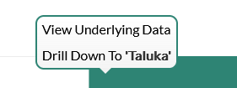
Dashboard
Progress Milestone

Slide 68
Dashboard
Work Status – “New” Schemes
Work Status – “Retro” Schemes

Slide 69
MS Project
Work in Progress Schemes

Slide 70
Sample Site Visit Photos

Slide 71
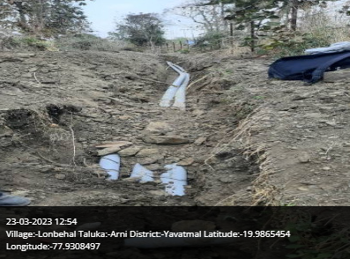
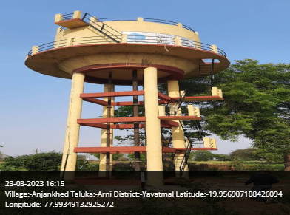
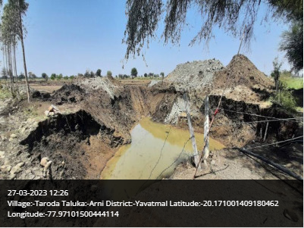
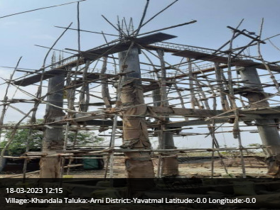
Arni Taluka

Slide 72
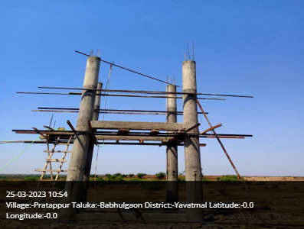
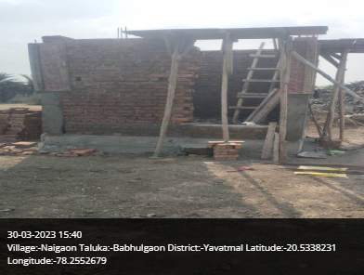
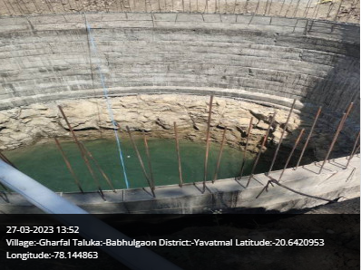
Babhulgaon Taluka

Slide 73
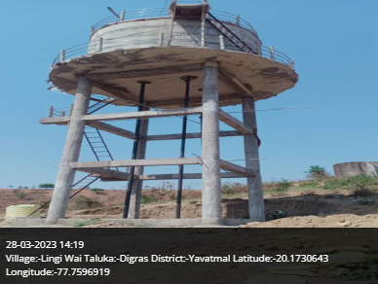
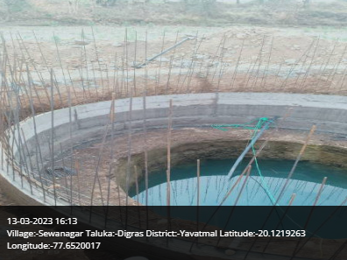
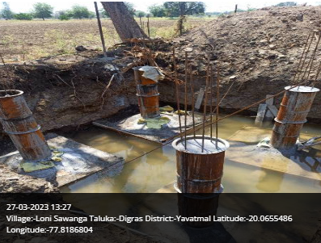
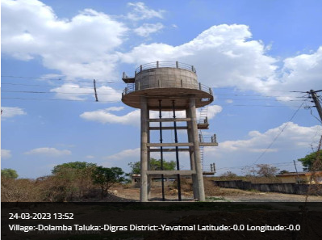
Digras Taluka

Slide 74
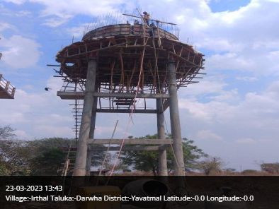
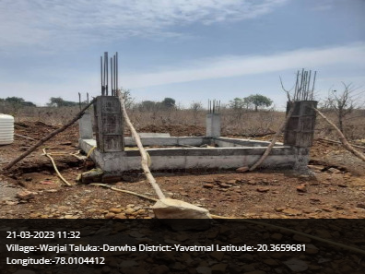
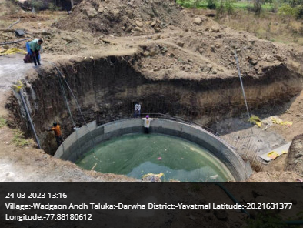
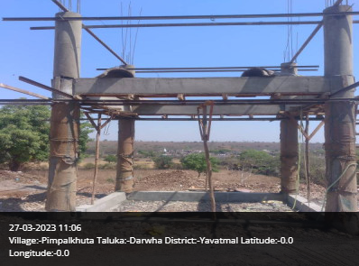
Darwha Taluka

Slide 75
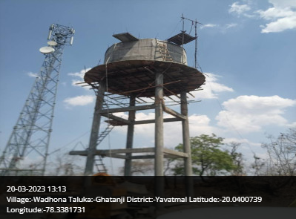
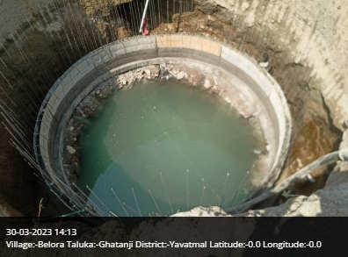
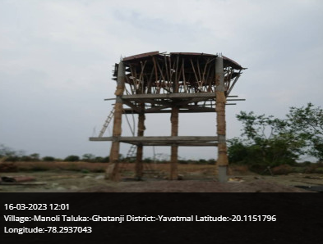
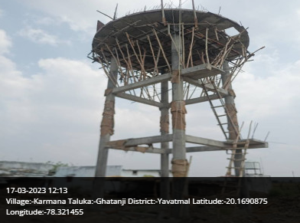
Ghatanji Taluka

Slide 76
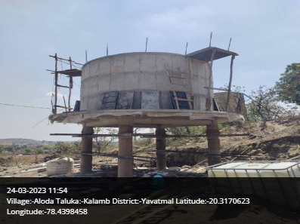
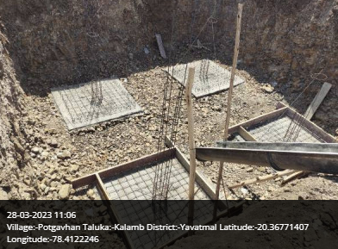
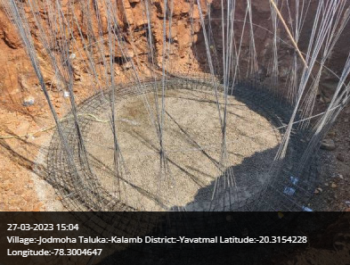
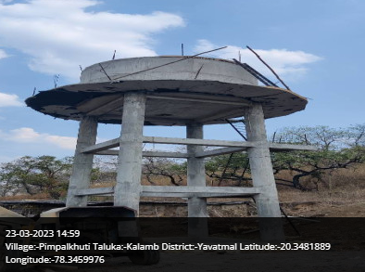
Kalamb Taluka

Slide 77
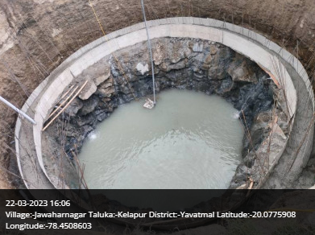
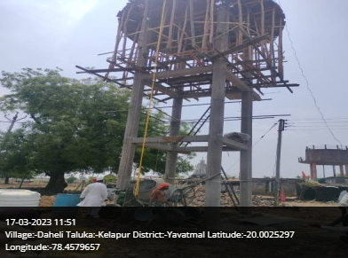
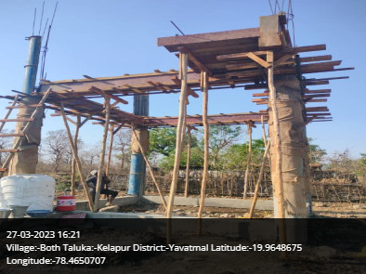
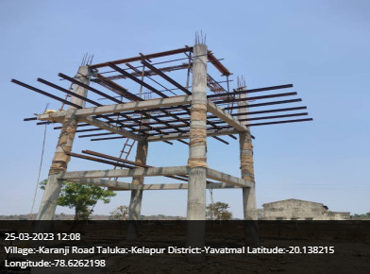
Kelapur Taluka

Slide 78
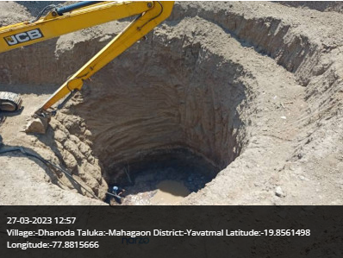
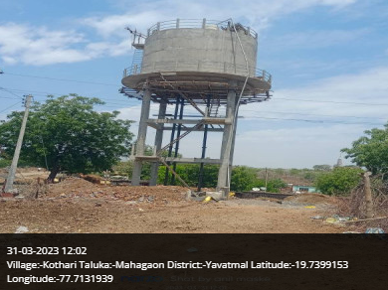
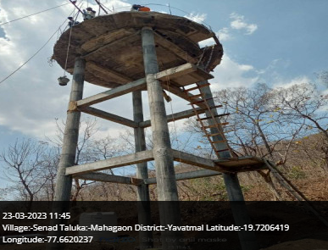
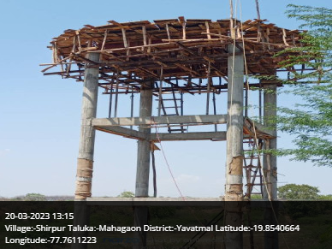
Mahagaon Taluka

Slide 79
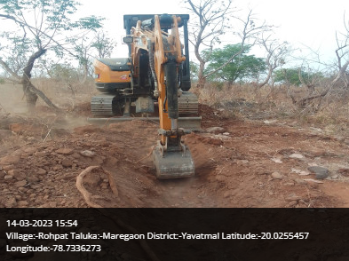
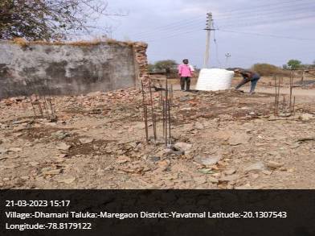
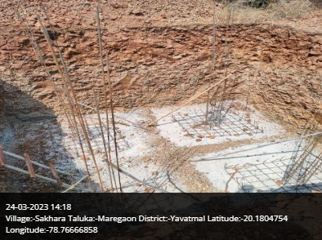
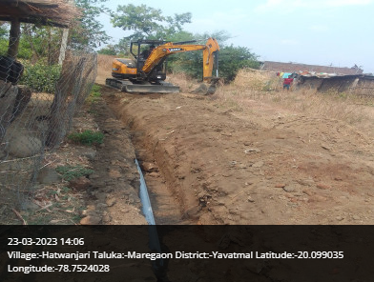
Maregaon Taluka

Slide 80
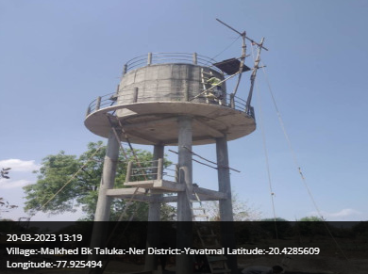
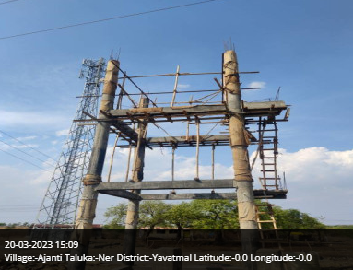
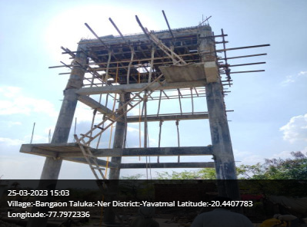
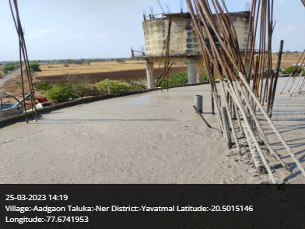
Ner Taluka

Slide 81
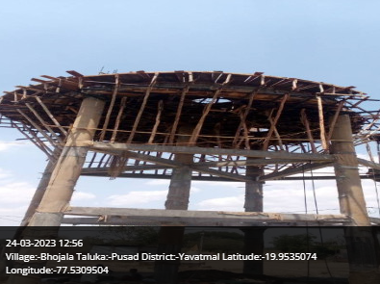
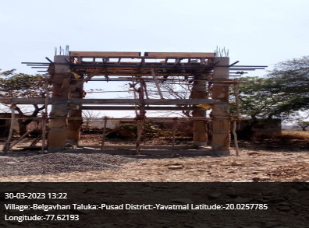
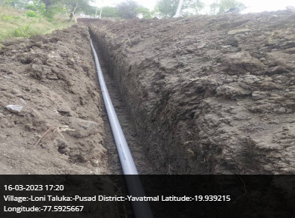
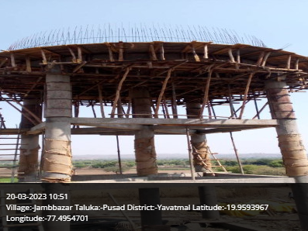
Pusad Taluka

Slide 82
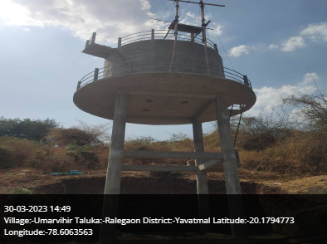
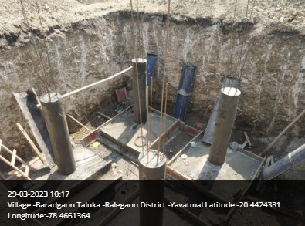
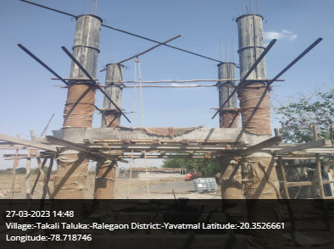
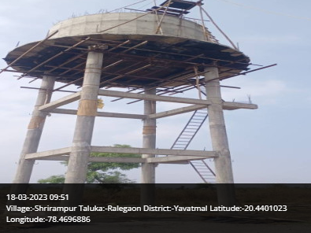
Ralegaon Taluka

Slide 83
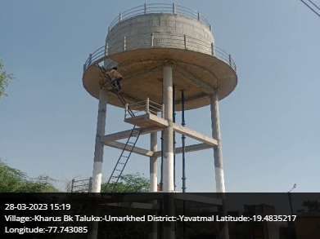
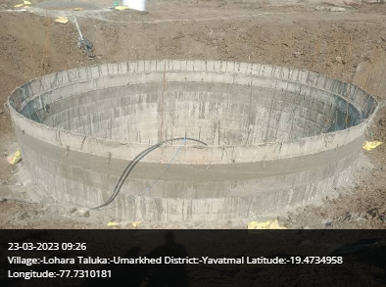


Umarkhed Taluka

Slide 84




Yavatmal Taluka

Slide 85




Wani Taluka

Slide 86




Zari Jamni Taluka

Slide 87

Thank You!

